Slide 1



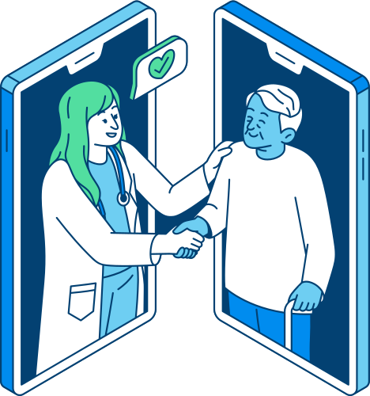
CS 147
streamlining the healthcare experience
Delali Bruce, Angela Mao, Susan Lee, Abbie Maemoto

Slide 2

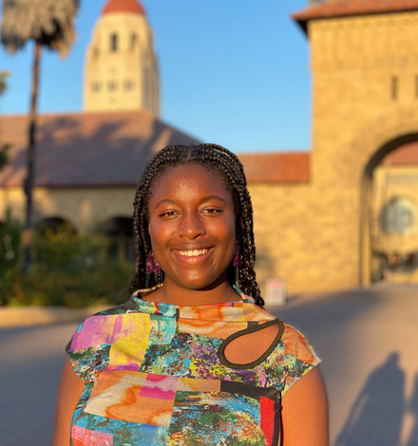


CheckUp Team
Susan Lee
Delali Bruce
Angela Mao
Abbie Maemoto

Slide 3


Problem Domain
Original
Big Idea: How do young people navigate their healthcare experience?
How do they find in-network care?
How do they understand their insurance?
How do they switch insurance when becoming independent?
Notes:
Last week we focused on how young people navigate their healthcare experience, particularly with insurance, diving into how they find care with their insurance network, how they understand their insurance and how to use it, and how they switch insurance when becoming adults.

Slide 4

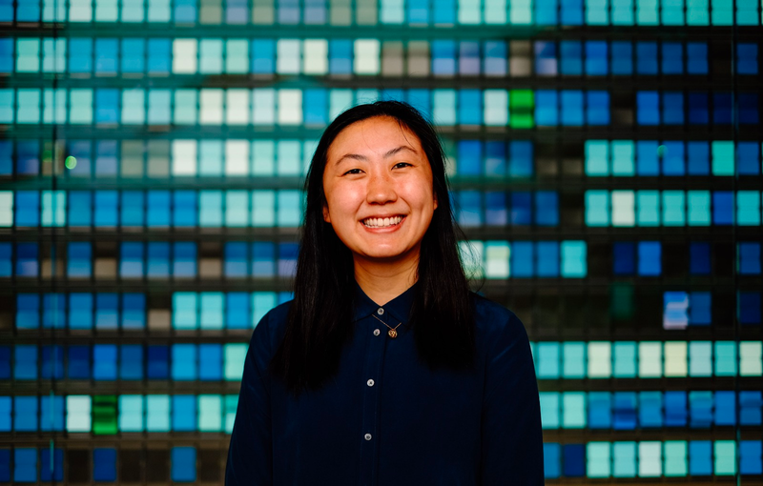
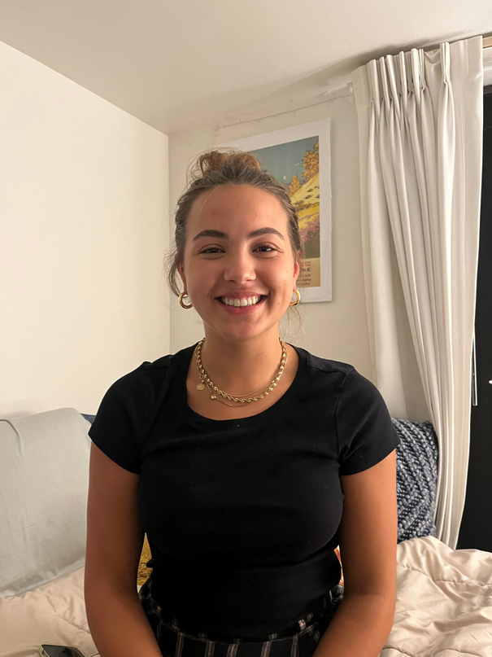
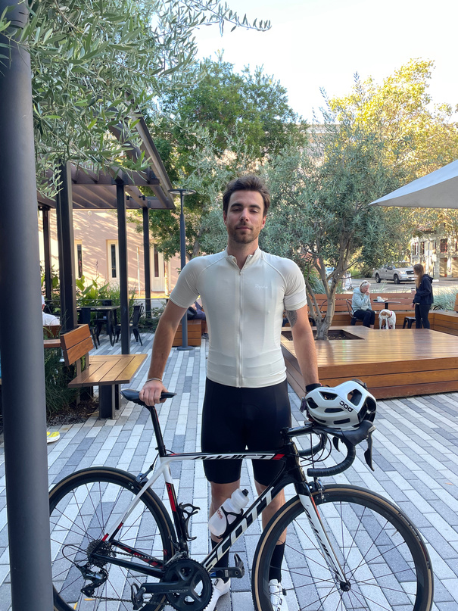

Previous Insights
Alia
Connie
Anastazja
Lyubo
“Bob”
  Had trouble finding and making personalized care decisions due to:
    location changes
    scheduling unavailabilities
  Expressed confusion about the health insurance decisions they had to make
Result: deciding on home remedies or forgoing care
Context: Lack of education
Notes:
We saw from many of our interviews that there were common themes when seeking care and dealing with health insurance. For example, Alia, Connie, and Anastazja all had trouble finding and making personalized care decisions either because they moved states or because of scheduling difficulties when finding a doctor. As a result, they either relied on home remedies and over-the-counter treatments to address their health concerns or even just gave up finding care altogether. In Lyubo and Bob's case, they were often unsure what the best health insurance for them was when selecting a new insurance with their employer; they noted that they just didn't know anything about what to look for, revealing that there is often a lack of education regarding health insurance

Slide 5
Problem Domain
More Focused
Most people are overwhelmed by the many decisions and information needed to navigate healthcare.
How can we educate and assist users in making healthcare decisions that will help them make easier and better decisions?
Notes:
Building upon these insights, we realized that most people are overwhelmed by the many decisions they have to make and the information needed to navigate their healthcare, whether it's finding a doctor or finding the best insurance for themselves, and oftentimes lack the proper information needed to make these decisions. So, we decided to hone in on the decision-making process of finding care: how can we educate and assist users in making healthcare decisions that will help them make easier and better decisions?

Slide 6
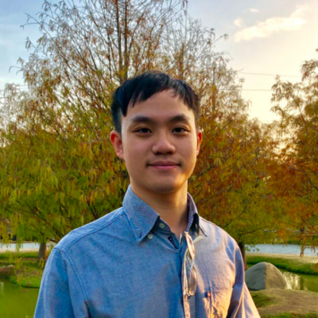
Needfinding Continued: Decisions
Digging deeper into the rationale and education behind healthcare decisions
“John”
Brad
Director of a wide-ranging health services network
Software Engineer
Notes:
To dig deeper into the rationale and education behind healthcare decisions, we interviewed John, the director a wide-ranging student health services network and Brad, a recent grad and software engineer. We tried to aim for a younger demographic than last week, targeting students and more recent grads, and also interviewed John for his insight into working with student health specifically.

Slide 7
Background:
  Age ~60
  Practicing Doctor
  Director of a wide-ranging health services network that provides various types of care to college students.
“If students end up needing care, they need to figure it out— the vast majority of students have no idea how to access their insurance until it gets bad.”
“John”
Director of a wide-ranging health services network

Slide 8


“John”: Key Findings
  Students have little to no understanding of their healthcare benefits and how to access their insurance
    Even more so for international students
  Resources are somewhat available but not really utilized
  Would love it if there was a class illuminating insurance
Need
There is a glaring need for more active education support for young people to learn about their healthcare needs and benefits
Notes:
John emphasized to us that students really don't have much understanding of their healthcare benefits, and interestingly even though resources exist, most students don't seem to be aware of them or even use them. He also highlighted that an active class on navigating health insurance would be something that students would probably appreciate. Overall, he highlighted that it's not just resources that are lacking when it comes to healthcare, but rather utilization and awareness of these resources that are lacking; we need more active education initiatives when it comes to teaching young people about their healthcare needs and benefits.

Slide 9
Background:
  24 years old
  Software engineer at large tech company
  Former international student
    Unfamiliar with American healthcare system coming from Taiwan
“I always have to plan ahead because doctors are always booked... for some clinics I have to check every day for availability.”
Brad
Software Engineer
Notes:
Our other interviewee was Brad, a recent college grad who works as a software engineer at a large tech company here. He's a former international student who is originally from Taiwan.

Slide 10

Brad: Key Findings
  Difficulty of scheduling appointments and long wait times at clinics
    Have to check constantly for availabilities, wasting time
  Utilized communities to make decisions and educate:
    Selecting doctors based on qualifications and personality
    Figuring out best insurance for himself
Need
An easier and faster way to schedule provider appointments and learn about insurance options (community-based).
Notes:
Brad was unfamiliar with long wait times and scheduling appointments coming from Taiwan, where you can walk in and get an appointment the same day. He constantly has to check for availabilities in appointments, wasting a lot of time for him. He also provided the insight that community-based education can be really valuable in determining the best doctor and insurance for himself, suggesting that the community can be an important resource in education.

Slide 11
POVs
Connie
“John”
Alia
Entrepreneur
Stanford GSB ‘22
Director of a wide-ranging health services network
Biotech Founder
Georgetown

Slide 12
FIRST POV
We met Connie, an entrepreneur in her late 20s who moved to the Bay several years ago to create several startups.
We were surprised to notice she gave up searching for a doctor and didn’t go for regular check-ups when she switched to Medi-cal even though she had past critical health issues.
We wonder if this means the stress of finding a doctor and scheduling check-ups is more stressful than the potential flare-ups of her past health issues.
It would be game-changing to streamline the process of searching for doctors and scheduling check-ups after switching to a new insurance.
Connie
Entrpreneur
Stanford GSB ‘22

Slide 13
HMW incentivize Connie to continue searching for doctors and get checkups instead of giving up?

Slide 14
SECOND POV
We met John, the director of a wide-ranging health services network that provides various types of care to college students.
We were surprised to notice that the vast majority of students have no idea how to access their healthcare until their conditions get bad or it is too late.
We wonder if this means that current educational resources regarding insurance and access to care aren’t effective enough or utilized enough.
It would be game-changing if we could help students access and utilize resources to understand their insurance in an impactful way sooner rather than later.
“John”
Director of a wide-ranging health services network

Slide 15

HMW educate students about their insurance at a younger age?

Slide 16
THIRD POV
We met Alia, a female entrepreneur who recently moved to the Bay and has been suffering from a recurring back injury because of various misdiagnoses.
We were surprised to notice that YouTube is often her “at-home doctor” which she uses to create physical therapy regimens when she can’t seek healthcare.
We wonder if this means that she prefers to take her healthcare matters into her own hands rather than switch to CA health insurance because of mistrust in the healthcare system.
It would be game-changing to leverage the desire for autonomy in healthcare to empower patients to proactively seek better treatments for medical needs.
Alia
Biotech Founder
Georgetown

Slide 17

HMW provide Alia the autonomy she desires in her healthcare while maintaining the integrity of medical information?

Slide 18

#1
CheckUp
an app that takes your online calendar, insurance information, and preferences to automatically book you appointments (sudden and recurring) with a simple request.
Critical Assumption
People put off receiving care if they are busy because booking appointments is perceived as a long and tedious process
Notes:
Your calendar is packed to the brim - work, class, dinner with your mom, hanging out with friends. Bumping your yearly checkup 6 months down the line… seems fine for now. That ear infection that’s “mild” right now? Maybe I’ll book an appointment tomorrow and go next week. We propose CheckUp, an app that looks at your online Calendar, takes your insurance information, and books your healthcare appointments for you, from the eye doctor to the dentist. You choose whether to accept or deny the appointments that your secretary makes for you, and you can specify any preferences about the doctor you see. Skip the long process of making multiple phone calls to several healthcare professionals to scrounge for a single time slot - leave it to our app. This solution works for both recurring healthcare appts and for any sudden health issues.

Slide 19
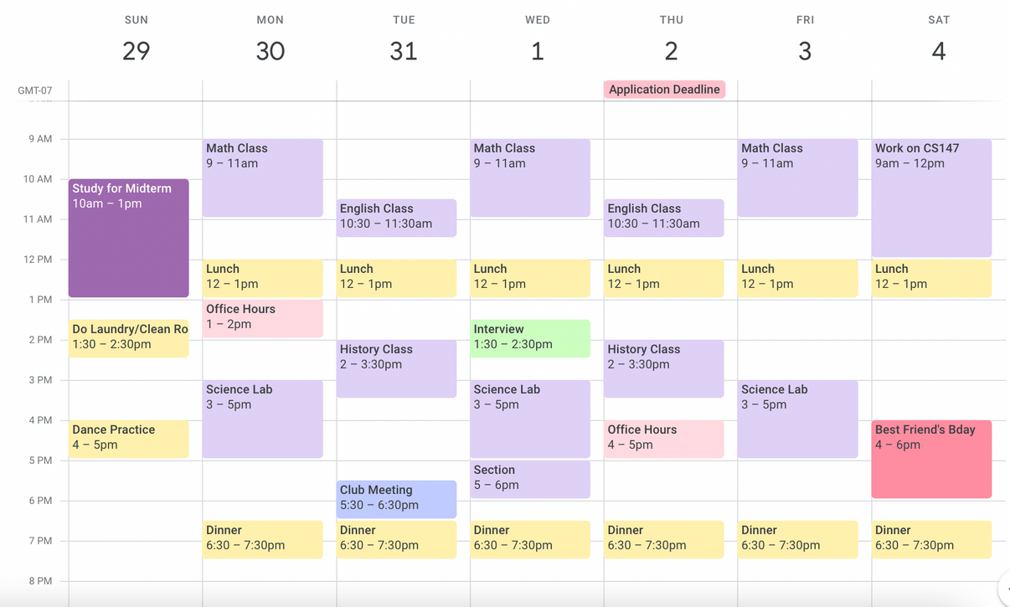
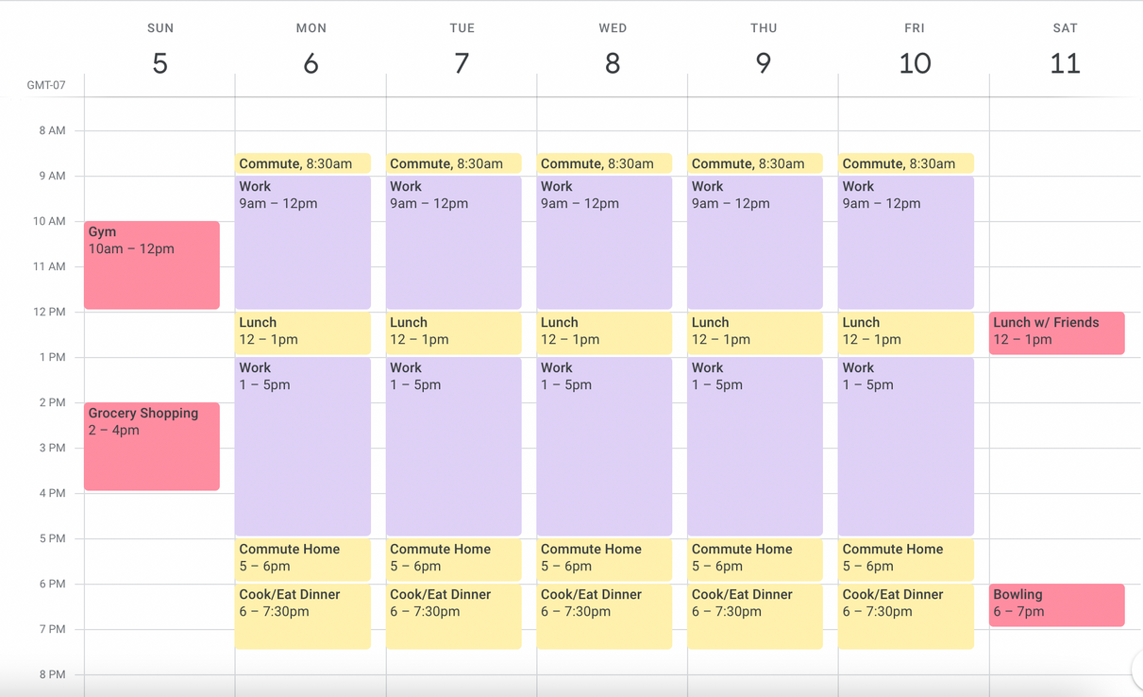
Experience Prototype
Created two calenders, one of a busy student and one of a busy professional
They were told that they got sick on Sunday with an ear infection
Asked when they would start looking for care, how long they expect it to take, when they would schedule the appointment, and why
Notes:
What we asked people: Hi! So first, I want to give you some context. You are a student or early career professional/intern right now. This is what your Google Calendar looks like for the next week. However, your ear starts hurting sunday night. When would you go and seek healthcare? Circle the time slot. How long do you think it will take to book your appt? Write a time down. When would you schedule the appt? Circle the time slot. Explain why you made those choices
We have two calendars - students and professionals, since we identified that these are ppl who move a lot to new places/are very busy.

Slide 20
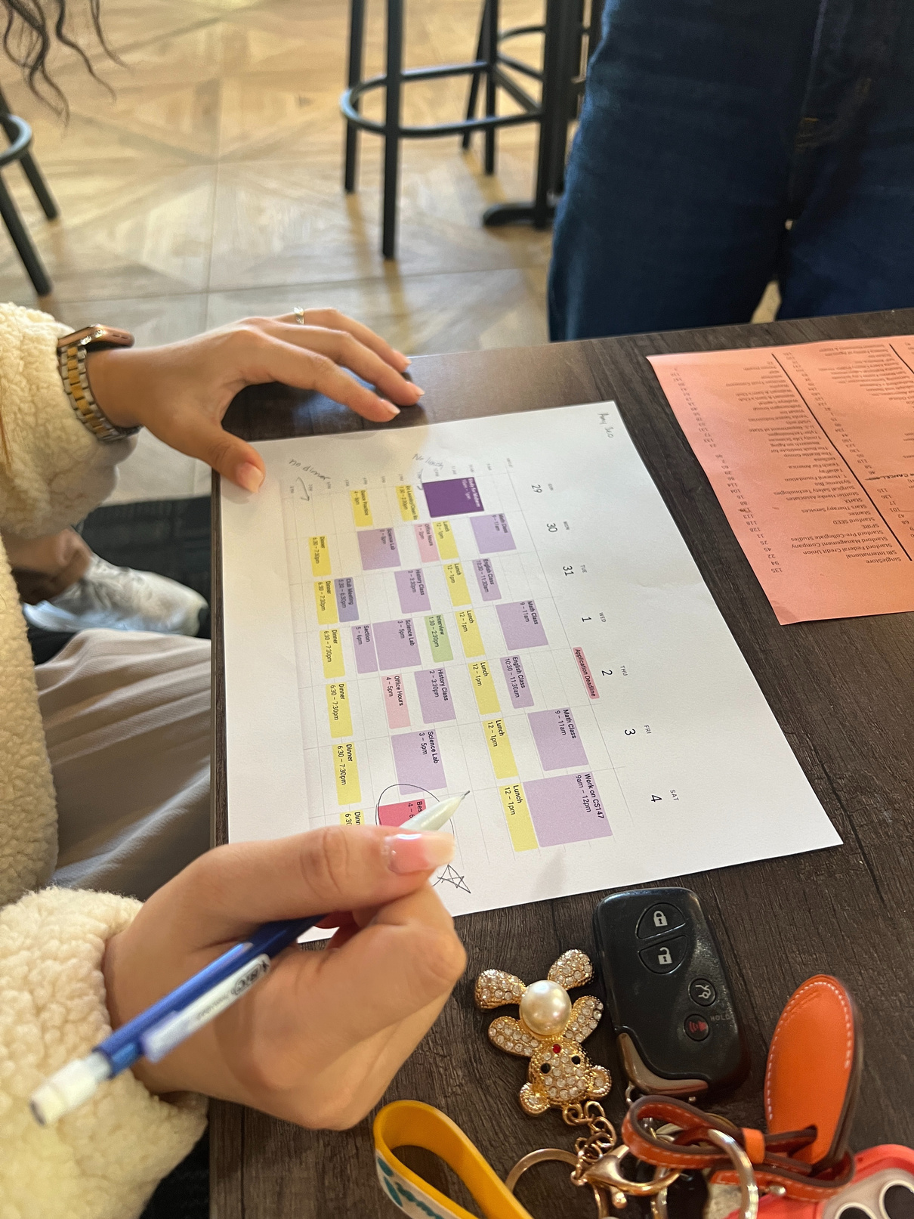
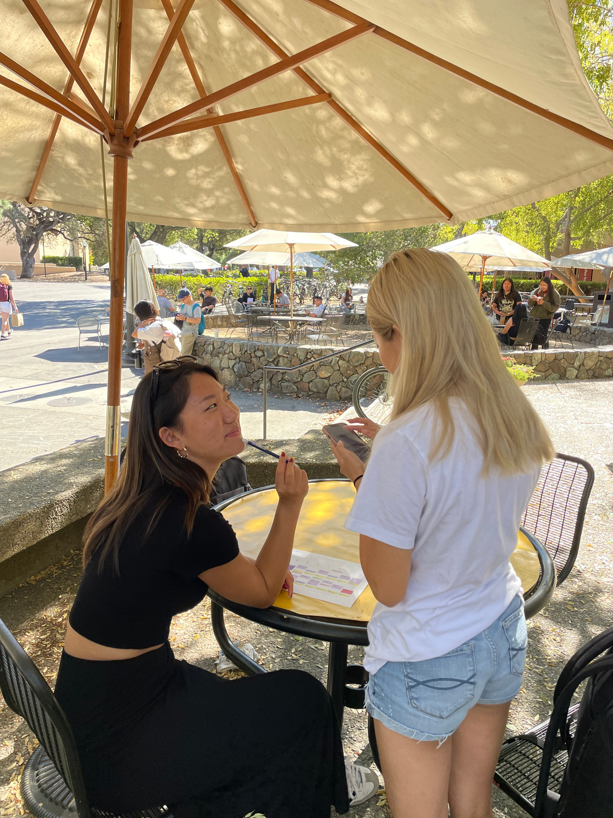
Our Participants
Various participants at the Career Fair
Notes:
We recruited participants from the Career Fair, and we talked to a mix of professionals and students. We have a diversity of participants, since we talked to people who were international, FLI, and not from the Bay Area (one of our participants was from Guam). They are relevant to our study because we are looking to talk to people who are juggling multiple responsibilities and where healthcare is seen as one of many "To Dos"

Slide 21
Results
What Worked
What Didn’t
  People carefully think through their scheduling process and genuinely are concerned about getting healthcare
  As per our assumption, people thought booking appointments would take around 30 mins - 1 hour of their time, and described it as “tedious”
  Some people said they would just go to a walk-in clinic without booking
  The Calendar only showed a really busy week, might not reflect “average” behavior
Many people are willing to run the risk of their symptoms getting worse/not feeling well because they prioritize other responsibilities, especially since booking appointments can be seen as long and tedious process. Many expressed that if they could book in a minute, they would.
How can we build a solution that accommodates for different users’ schedule priorities and book appointments fast so that users get the care they need without delays?
Insights
Notes:
Our initial assumption: People also put off receiving care if they are busy because booking appointments is seen as tedious
Many people expressed that they wouldn’t call until Monday/Tuesday or until symptoms got really bad
They expected the search to booking process to take around 30 mins - 1 hour of their time, and described it as “tedious”. Some described themselves as "lazy" and wouldn't do it unless it started to seriously affect their work. One participant even said on the professional calendar that she would go a week without healthcare.

Slide 22
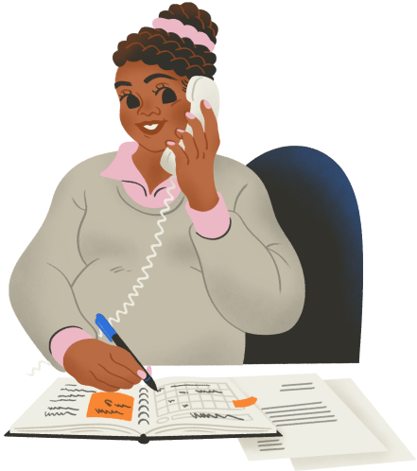
#2
CoPal
a virtual assistant that walks you through your healthcare needs & recommends relevant health options based on user’s questions
Critical Assumption
A user trusts what a virtual assistant / chatbot says. They trust it with their health questions.
Notes:
Our second solution is CoPal, a virtual assistant that walks you through your healthcare needs and recommends relevant health options based on a user's questions. This solution relies on the assumption that a user is able to trust what a virtual assistant or chatbot says and trust them with potentially vulnerable health questions.

Slide 23
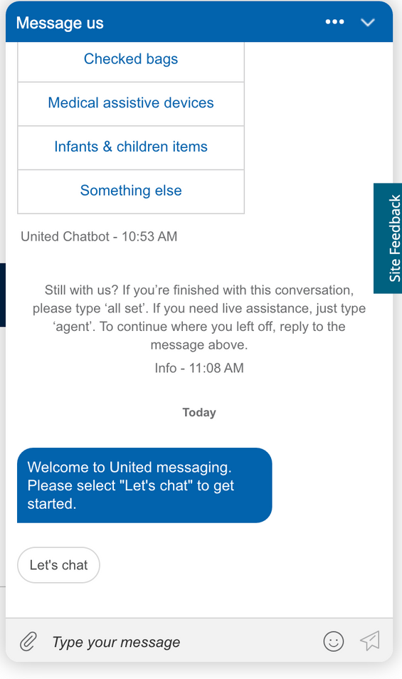
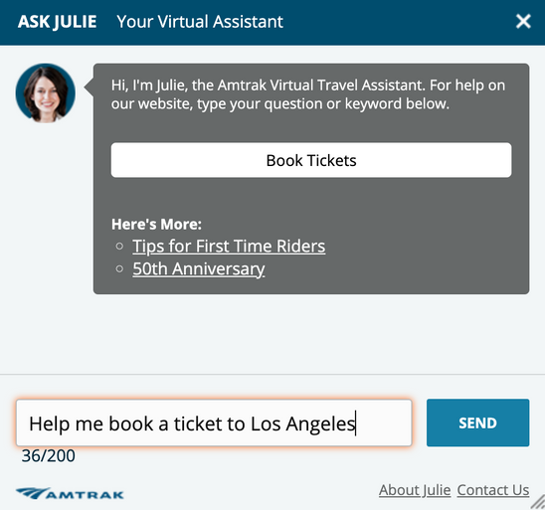
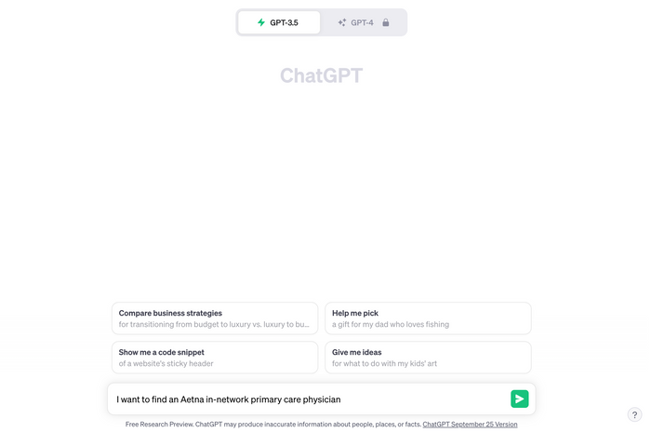
Experience Prototype
A target user was selected to interact with 3 online chatbots/virtual experiences
They were given an objective for their interaction (i.e. find a train ticket to LA)
Asked to gauge how much they trusted the results of the interaction
Notes:
We led users to interact with 3 online chatbots/virtual experiences (ChatGPT, Amtrak's Julie, United) with an objective, such as asking for help to book a train ticket to LA. At the end, we asked users to reflect on the experience, particularly probing how much they trusted their interactions with the chatbot.

Slide 24
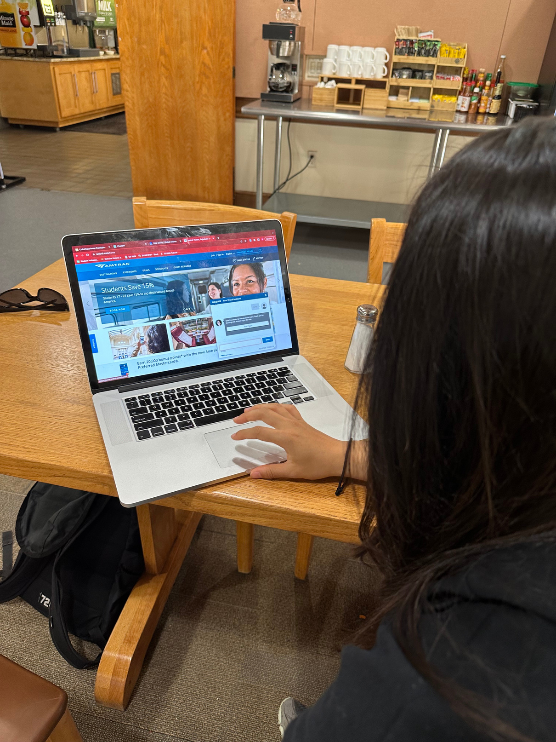
Our Participant
Anonymous International Stanford Student
Notes:
We recruited one international Stanford student who wished to remain anonymous, but was recruited through mutual friends. As an international student, we were especially curious about her trust in asking a chatbot about systems that may be unfamiliar to her, such as navigating the train system in America.

Slide 25
Results
What Worked
What Didn’t
  The interactions that involved a chatbot provided through a service were more trustworthy than a standalone chatbot like ChatGPT
  Interactions were most positive when the user was able to get the result they wanted
  Some chatbots were more clunking / the UI was unclear making it hard for the user to get the results that they wanted.
  Lack of specifics in the prompt made the chat’s answer super generic
Trust is more likely when the chatbot is connected to / developed by a company where the service is provided rather than a stand alone chatbot that is not affiliated with the specific industry
How can we build a platform where the user can believe the results given to them even if it is not directly connected to a healthcare company?
Insights
Notes:
What worked:
- The interactions that involved a chatbot provided through a service were more trustworthy than a standalone chatbot like ChatGPT
- Interactions were most positive when the user was able to get the result they wanted! The user trusted the service more when this happened.
What didn't:
- Some chatbots were more clunking / the UI was unclear making it hard for the user to get the results that they wanted.
- In the ChatGPT interaction, the lack of specifics in the prompt made the chat’s answer super generic and therefore not helpful.
Insights:
- Trust is more likely when the chatbot is connected to / developed by a company where the service is provided rather than a stand alone chatbot that is not affiliated with the industry or service it is giving recommendations on (ie chatGPT has less credibility giving healthcare advice compared to an insurance company’s chatbot)
- Question: How can we build a platform where the user can believe the results given to them even if it is not directly connected to a healthcare company / industry?

Slide 26

#3
DocDIY
your virtual hub for finding the most relevant cross-media content for at-home care based on patient’s current health needs
Critical Assumption
When first addressing healthcare concerns, young people value saving money and ease-of-access over quality of care.

Slide 27
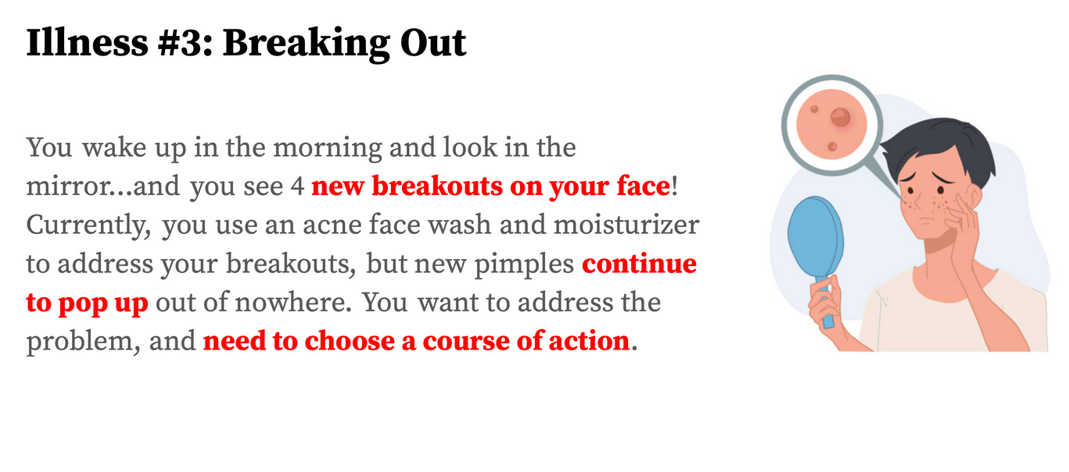
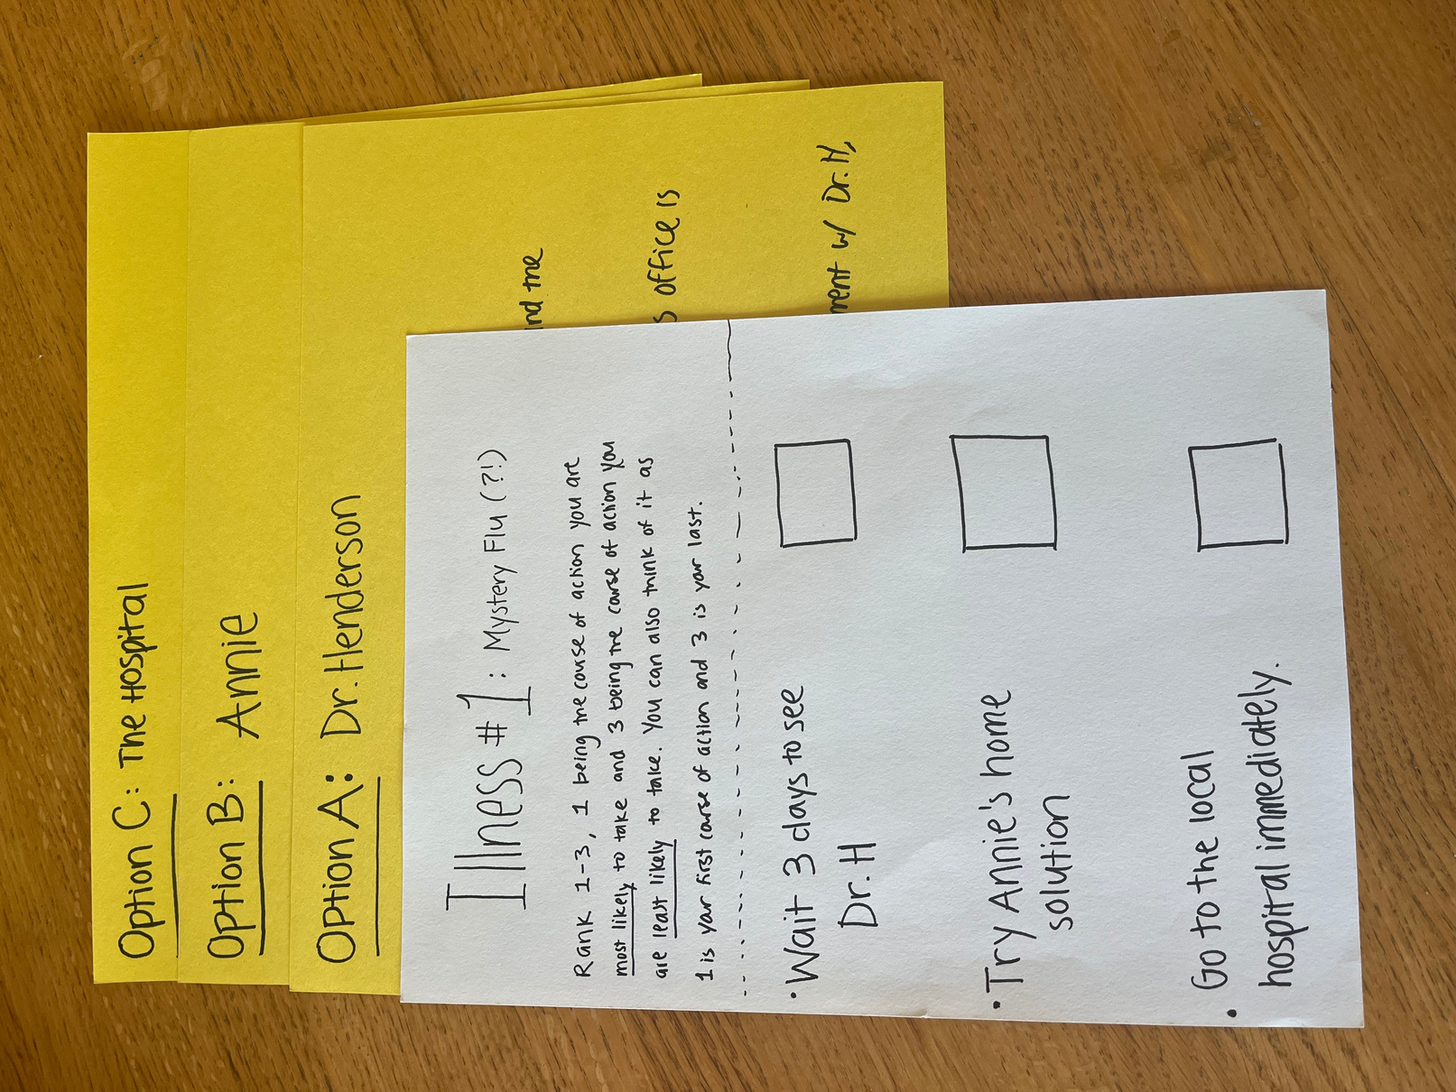
Experience
Prototype
User was given a scenario where they were sick/injured
User was then given 3 distinct treatment plan options created upon different metrics including cost, time, and quality of care.
User was asked to rank each option from 1 to 3, 1 being the first line of action. This process was repeated for a second scenario.

Slide 28
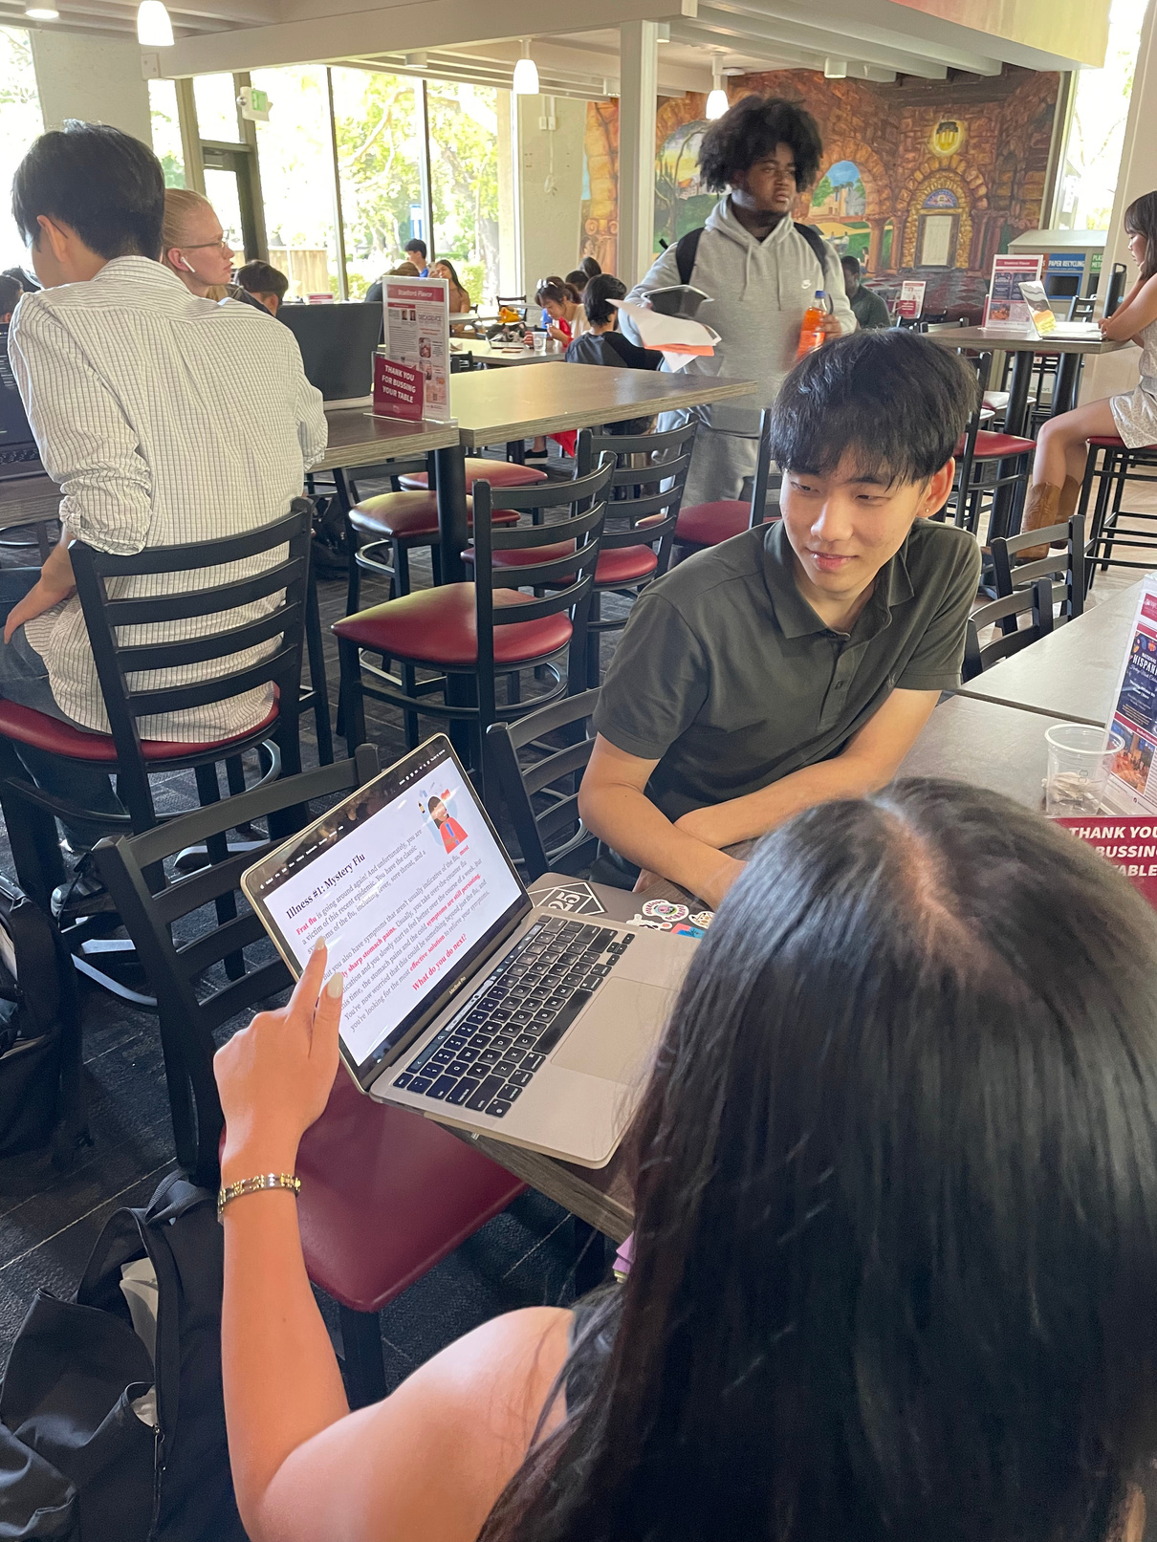
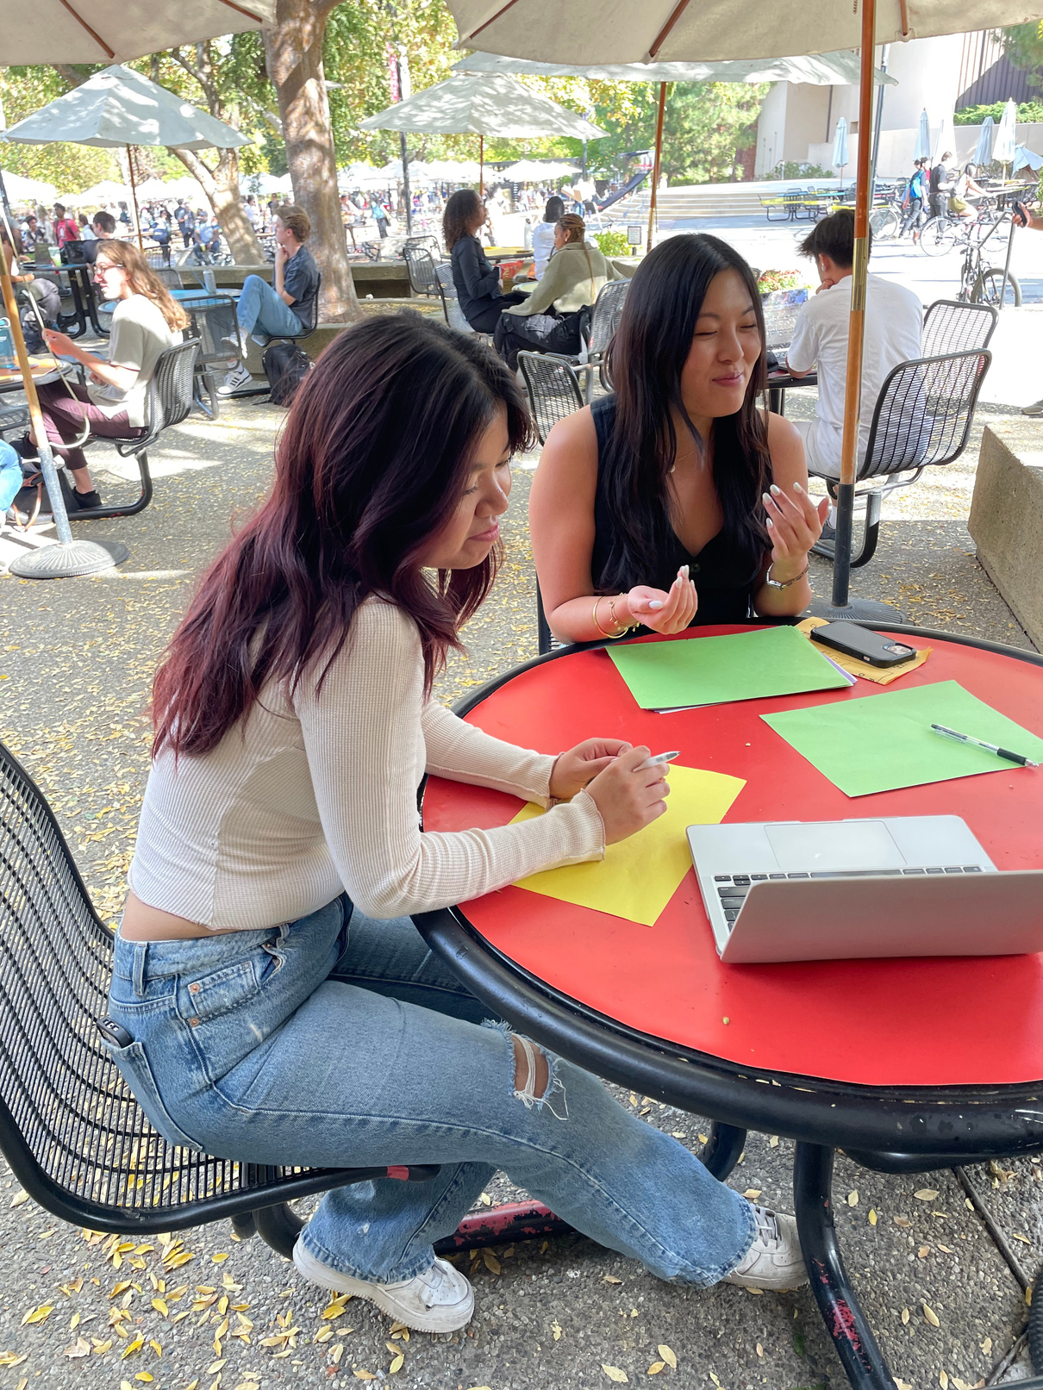
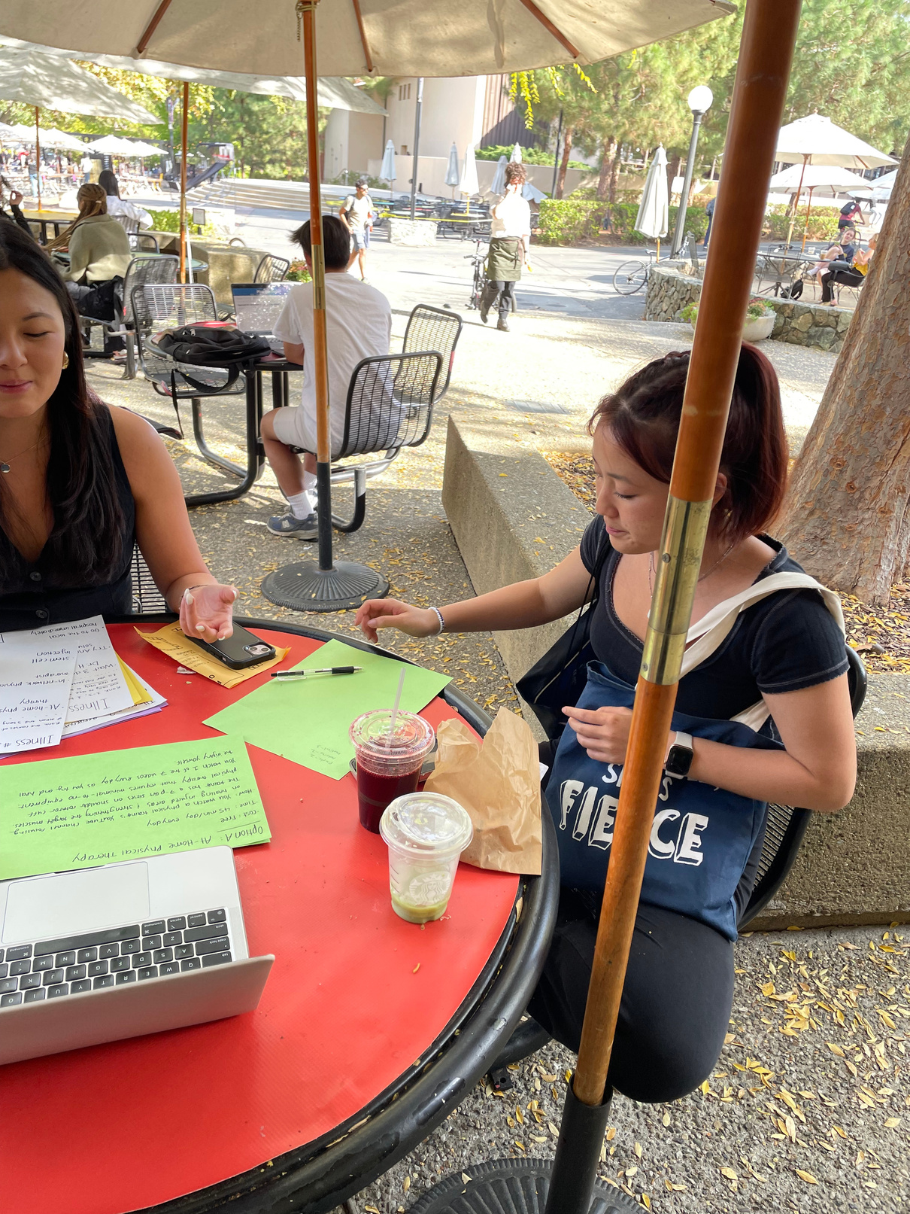
Participants
Notes:
We recruited 4 Stanford students at Tresidder by sitting at tables and asking participants to sit down with us for a quick experience. All of them were Stanford undergraduates, and each of them were relevant as people who have all suffered from various, mostly minor health conditions that needed some type of care.

Slide 29
Results
What Worked
What Didn’t
  The scenarios were believable and the users mentioned relating to some injuries/illnesses
  Users took time to engage with the paper materials and slides beyond what was verbally conveyed.
  Some of the treatment options were considered so drastic that they were not seriously considered
  One user was skeptic of all the treatment options as they would rather go to a professional.
Insights
Young people prefer to address their healthcare concerns themselves as a first line of treatment, rather than see a doctor if they can mitigate symptoms over the course of a few days.
How can we leverage the multitude of existing cross-platform media content to help patients better help themselves?
Notes:
Note that users carefully studied their options and were thinking as if they were confronting the scenarios in real-life; suggests home-remedy research is a viable sollution.

Slide 30
What’s Next?
  Clear functionality and user end goal
  Does not currently exist
  Consists of actionable tasks
  Need to explore recurring appointments
CheckUp
Ethics
User Bias
  Could perpetuate racial biases in doctor selection
  Data privacy concerns
  Integration with calendar services: how to guarantee privacy?
Serves young people and working professionals who have packed day-to-day schedules
  Excludes elderly & less tech-savvy communities
  Excludes people who don’t use calendar apps
Notes:
After testing out various solutions and observing what users liked and didn't like, we ultimately decided to go with CheckUp. Being less complicated than the other solutions, users were able to make their decisions and interact with the prototype quickly and without much explanation; it was the most intuitive solution out of all of them. It also had the clearest action; ultimately, users had a scheduled appointment based on their schedule, personal priorities, and preferences on how fast they wanted to be seen. As we continue on with this solution however, there are some concerns that we will continue to watch for, such as ethical concerns that CheckUp could perpetuate racial biases in selecting a doctor appointment, and also data privacy concerns in sharing information to make an appointment, sharing your calendar info, and more. There are also potential user biases to watch out for, such as the fact that older populations and less tech-savvy communities may be left out by our solution, and also people who don't operate with calendars in their daily lives.

Slide 31
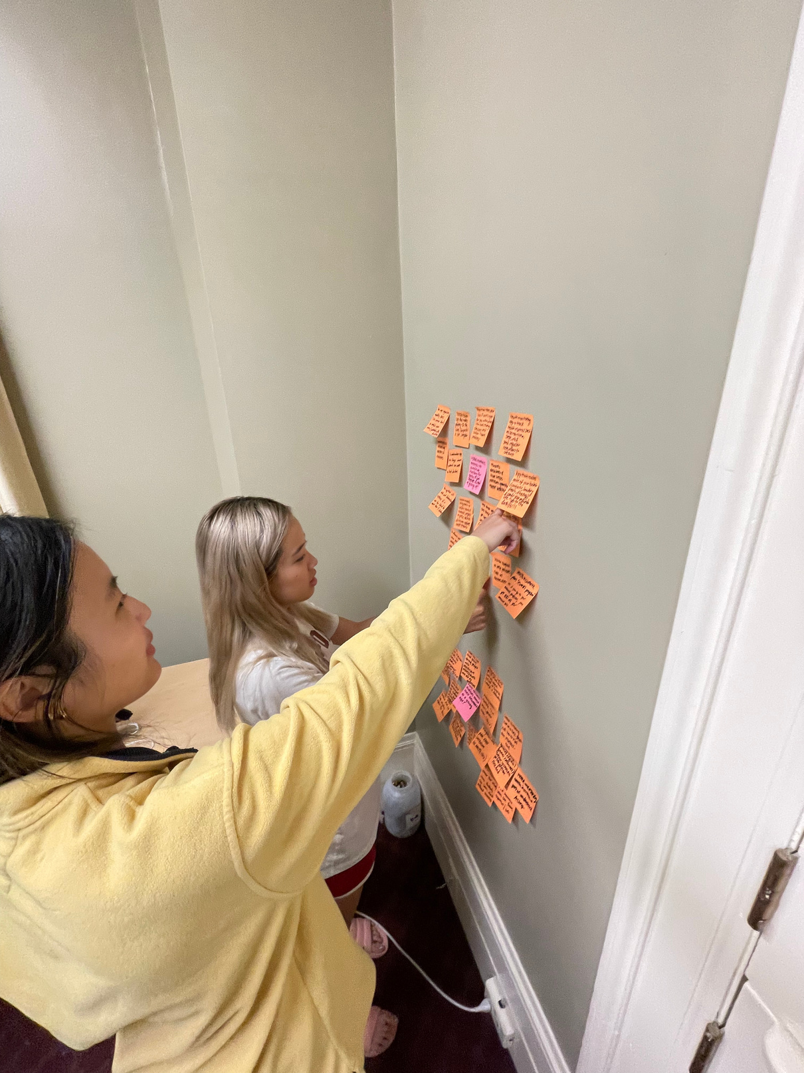
Thank You!
Questions?

Slide 32
Appendix
a. 10+ HMW Brainstorms
b. 10+ Solution Brainstorms
c. CheckUp Google Calender Prototypes

Slide 33
Connie HMW Brainstorm
HMW separate unavailable doctors from available doctors more clearly?
HMW make the insurance switch process like the college transfer process?
HMW incentivize patients to continue searching for doctors and get checkups instead of giving up?
HMW make the search process for finding doctors insightful rather than annoying?
HMW leverage known failed doctor searches to update and inform the doctor search process?
HMW remove the burden of finding doctors from the patients?
HMW facilitate communication between insurance, doctors, and patients to streamline the doctor search process?
HMW entirely remove the search process for finding doctors?
HMW make the search process for finding doctors something to look forward to?
HMW use previous satisfying doctor experiences to inform the doctor search process with the new insurance?
Notes:
These are the 10 HMWs we generated from Connie's POV:
HMW separate unavailable doctors from available doctors more clearly?
HMW make the search process for finding doctors insightful rather than annoying?
HMW entirely remove the search process for finding doctors?
HMW leverage known failed doctor searches to update and inform the doctor search process?
HMW remove the burden of finding doctors from the patients?
HMW make the insurance switch process like the college transfer process?
HMW make the search process for finding doctors something to look forward to?
HMW use previous satisfying doctor experiences to inform the doctor search process with the new insurance?
HMW incentivize patients to continue searching for doctors and get checkups instead of giving up?
HMW facilitate communication between insurance, doctors, and patients to streamline the doctor search process?

Slide 34
John HMW Brainstorm
HMW standardize co-pays across the US?
HMW alleviate the feeling of lack of access to care for students?
HMW remove the burden of co-pay for students?
HMW better respond to student demand for care in a timely fashion?
HMW make the process of hiring physicians less arduous / more efficient?
HMW place health responsibilities onto young people at an earlier point in their lives?
HMW increase communication between healthcare providers and their constituents?
HMW vary the amount of staffing on a month-by-month basis?
HMW educate students about their insurance at a young age?
HMW normalize conversations about insurance amongst young people?
“There needs to be wider coverage with Medicare”
HMW track co-pay metrics from state to state?
Notes:
These are the 10 HMWs generated from John's POV:
HMW standardize co-pays across the US?
HMW make the process of hiring physicians less arduous / more efficient?
HMW remove the burden of co-pay for students?
HMW alleviate the feeling of lack of access to care for students?
HMW educate students about their insurance at a young age?
HMW normalize conversations about insurance amongst young people?
HMW place health responsibilities onto young people at an earlier point in their lives?
HMW increase communication between healthcare providers and their constituents?
HMW better respond to student demand for care in a timely fashion?
HMW vary the amount of staffing on a month-by-month basis?
HMW track co-pay metrics from state to state?

Slide 35
Alia HMW Brainstorm
HMW reduce the rates of misdiagnosis?
HMW help people easily switch in-state insurance plans upon moving?
HMW better early detection of a recurrent injury?
HMW automate the creation of personalized lifestyle regimens based on watched content?
HMW help people find affordable primary care in a new city?
HMW create better ways to continue tracking recurrent injuries?
HMW provide patients the autonomy they desire in their healthcare while maintaining the integrity of medical information?
HMW eliminate the need to go back home for care?
HMW distinguish between recurrent and one-off incident injuries?
HMW eliminate in-state only plans?
HMW foster greater long-term trust between new doctors and patients?
HMW help self-employed entrepreneurs find reliable health insurance plans?
Notes:
These are the HMWs for Alia:
HMW reduce the rates of misdiagnosis?
HMW better early detection of a recurrent injury?
HMW help people find affordable primary care in a new city?
HMW help people easily switch in-state insurance plans upon moving?
HMW automate the creation of personalized lifestyle regimens based on watched content?
HMW foster greater long-term trust between new doctors and patients?
HMW eliminate in-state only plans?
HMW distinguish between recurrent and one-off incident injuries?
HMW create better ways to continue tracking recurrent injuries?
HMW provide patients the autonomy they desire in their healthcare while maintaining the integrity of medical information?
HMW eliminate the need to go back home for care?
HMW help self-employed entrepreneurs find reliable health insurance plans?

Slide 36
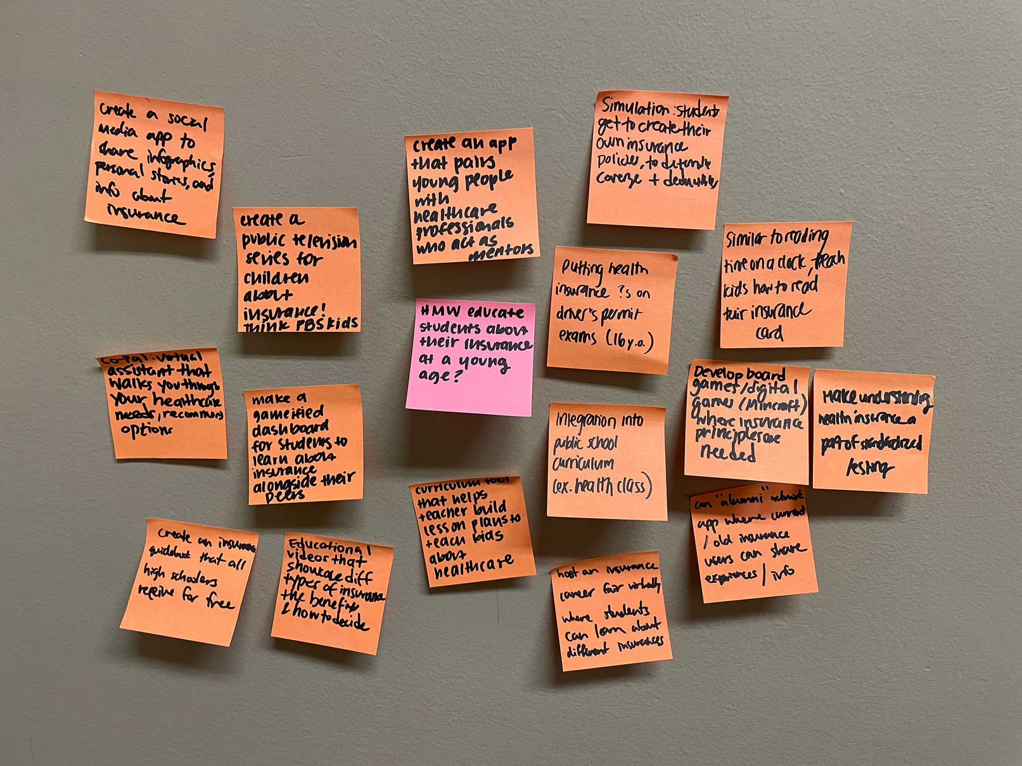
Solution Brainstorm 1
Notes:
Brainstorm for HMW educate students about their insurance at a young age?
Solution chosen was CoPal, a virtual assistant that walks you through your healthcare needs and recommends health options.

Slide 37
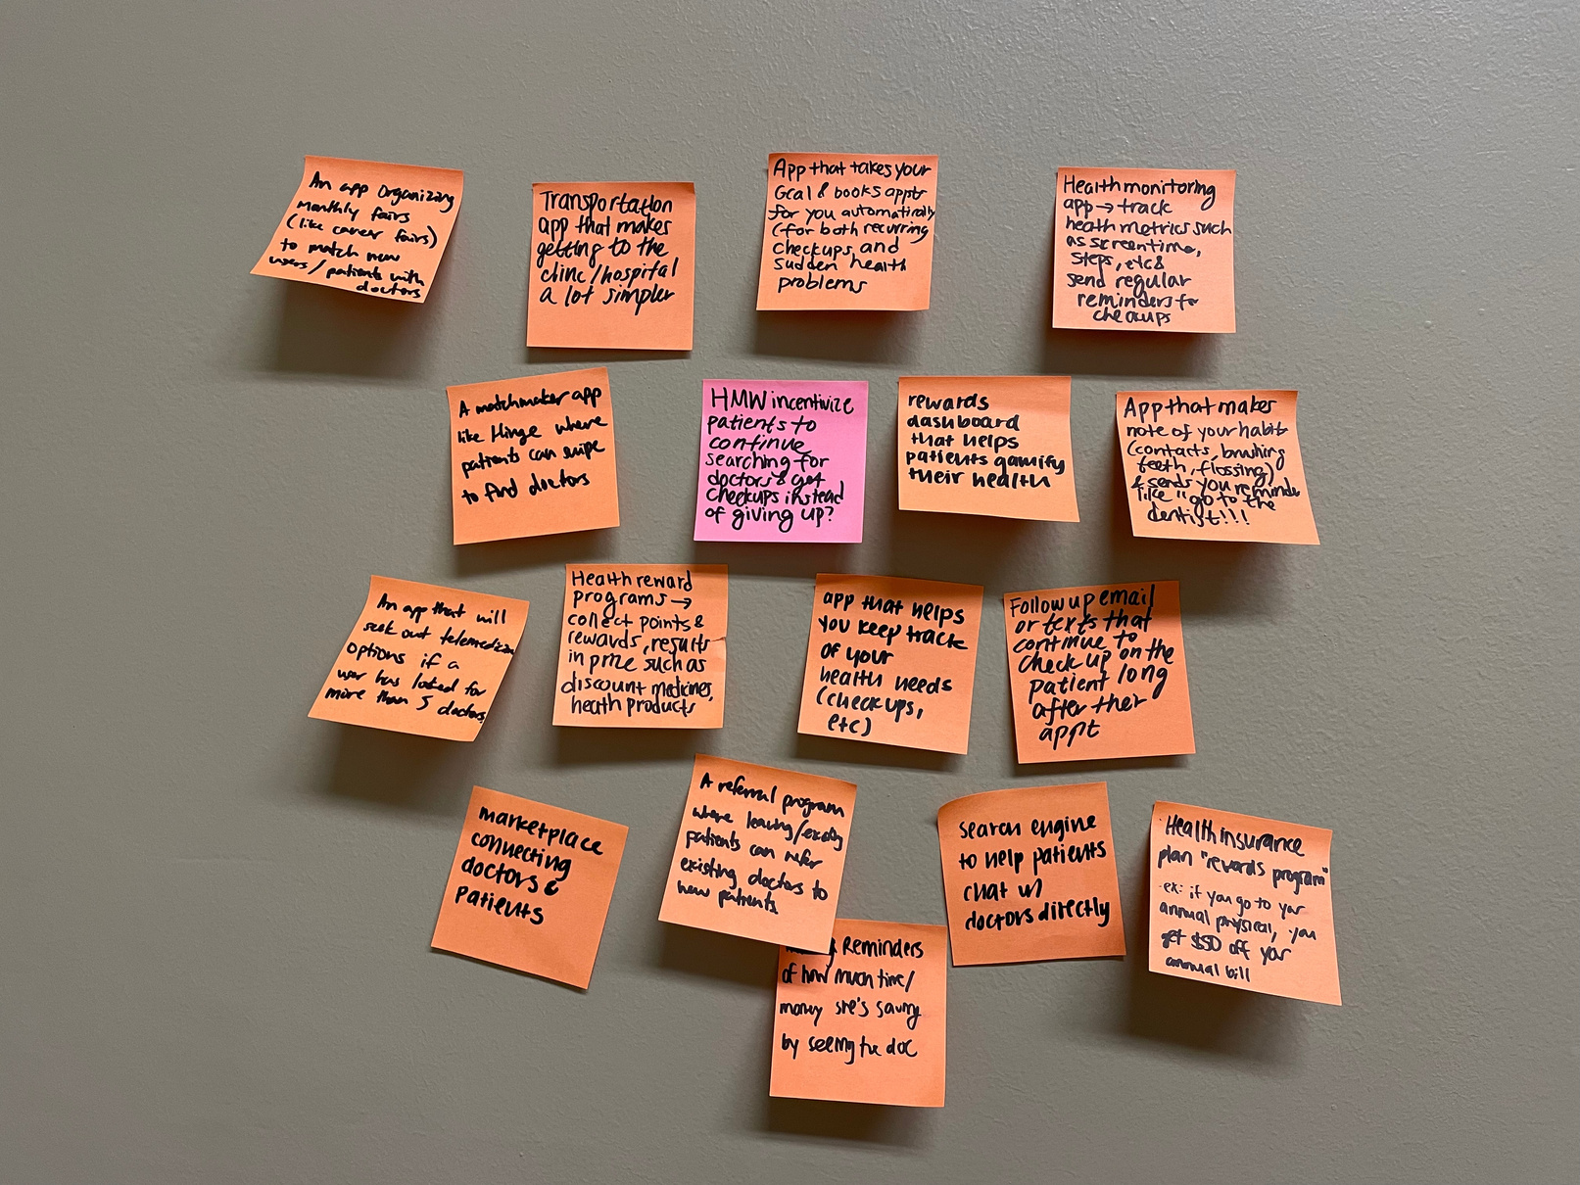
Solution Brainstorm 2
Notes:
This is the brainstorm for HMW incentivize patients to continue searching for doctors and get checkups instead of giving up?
The solution chosen was CheckUp

Slide 38
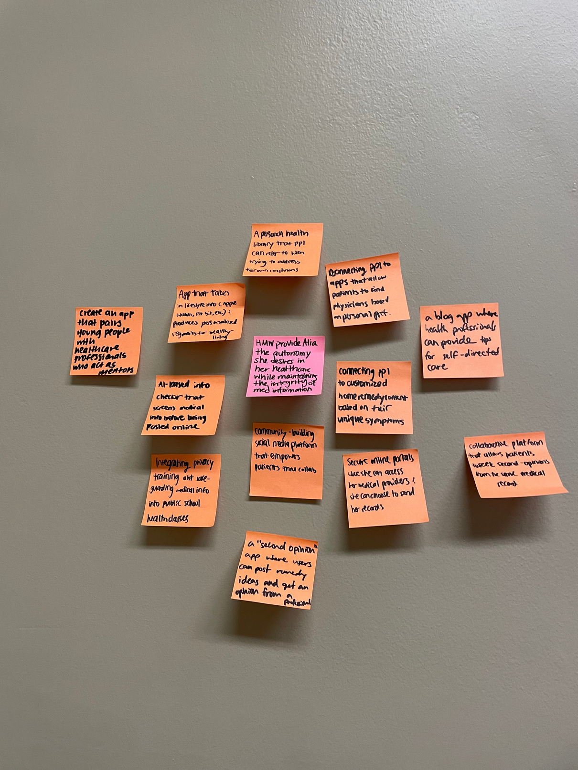
Solution Brainstorm 3
Notes:
This is the brainstorm for HMW provide Alia the autonomy she desires in her healthcare while maintaining the integrity of medical information?
The Solution chosen was DocDIY

Slide 39

Calender Prototype #1 (Student)

Slide 40

Calender Prototype #2 (Professional)

Slide 41
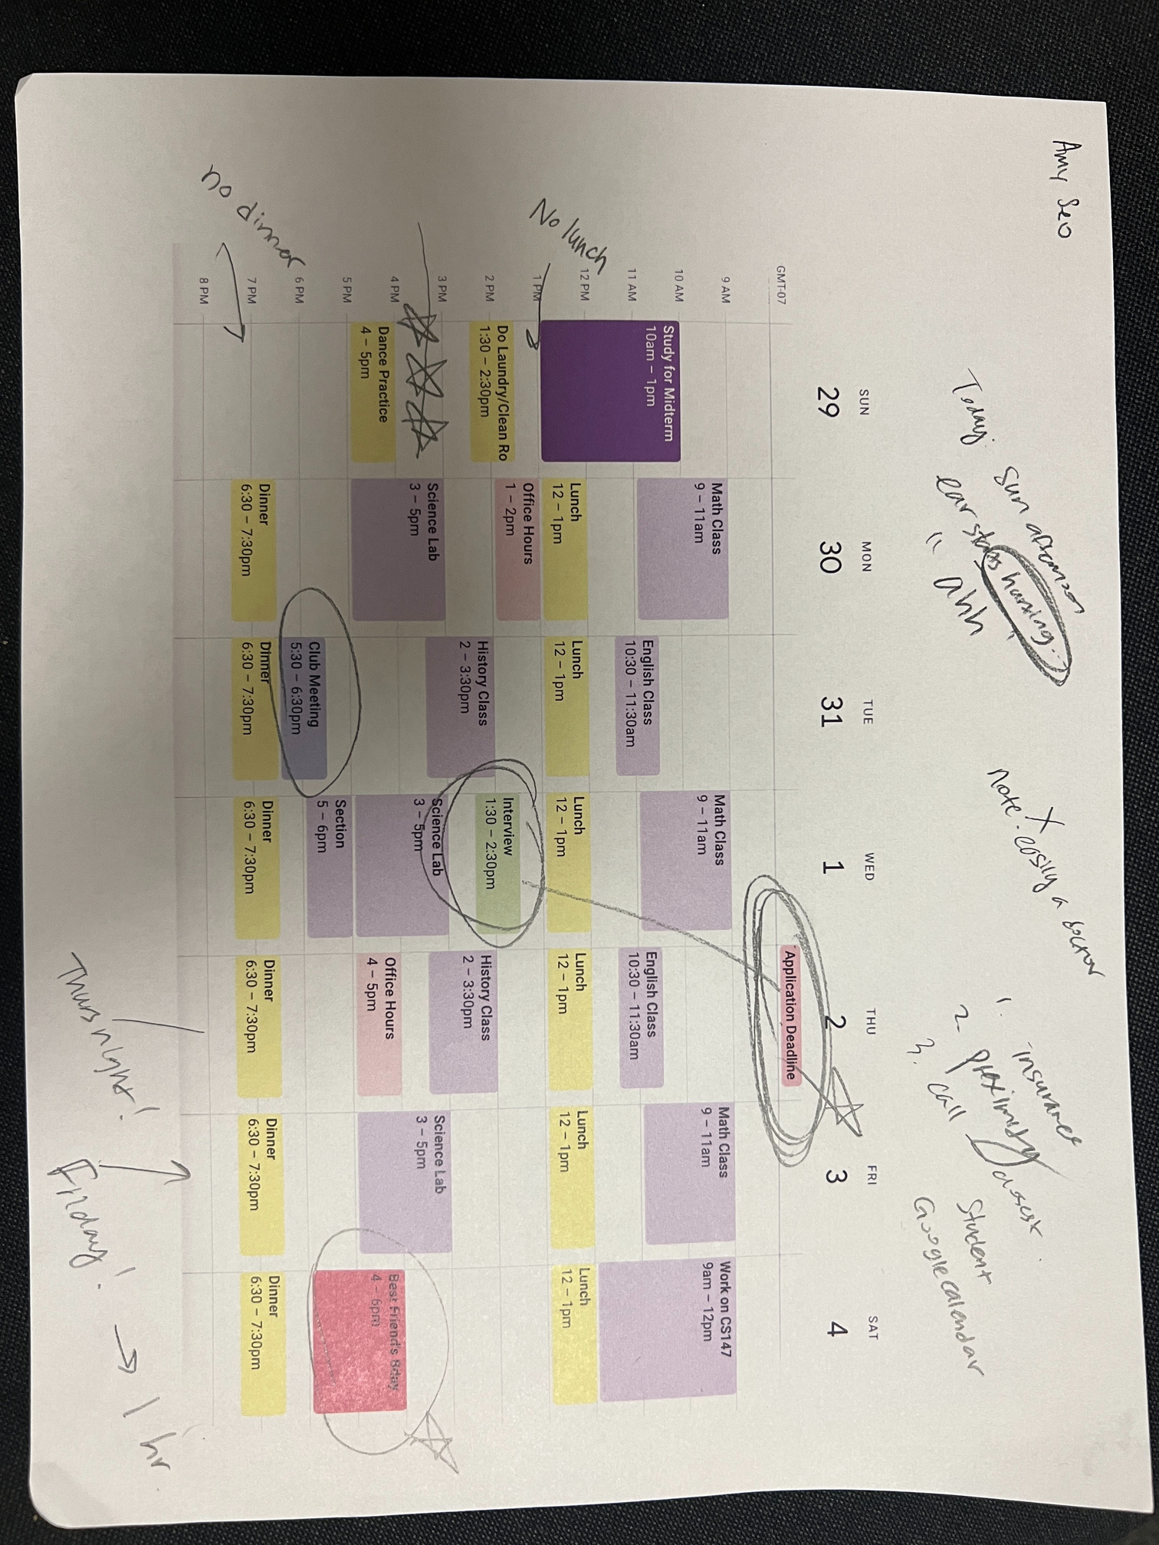
Filled out Calender Prototype
Notes:
This is a filled out calendar that one of participants filled out, she wrote out her thinking process very clearly and how she perceived the process of getting healthcare

