Slide 1
Mental Health for Adults
Needfinding Report

Slide 2
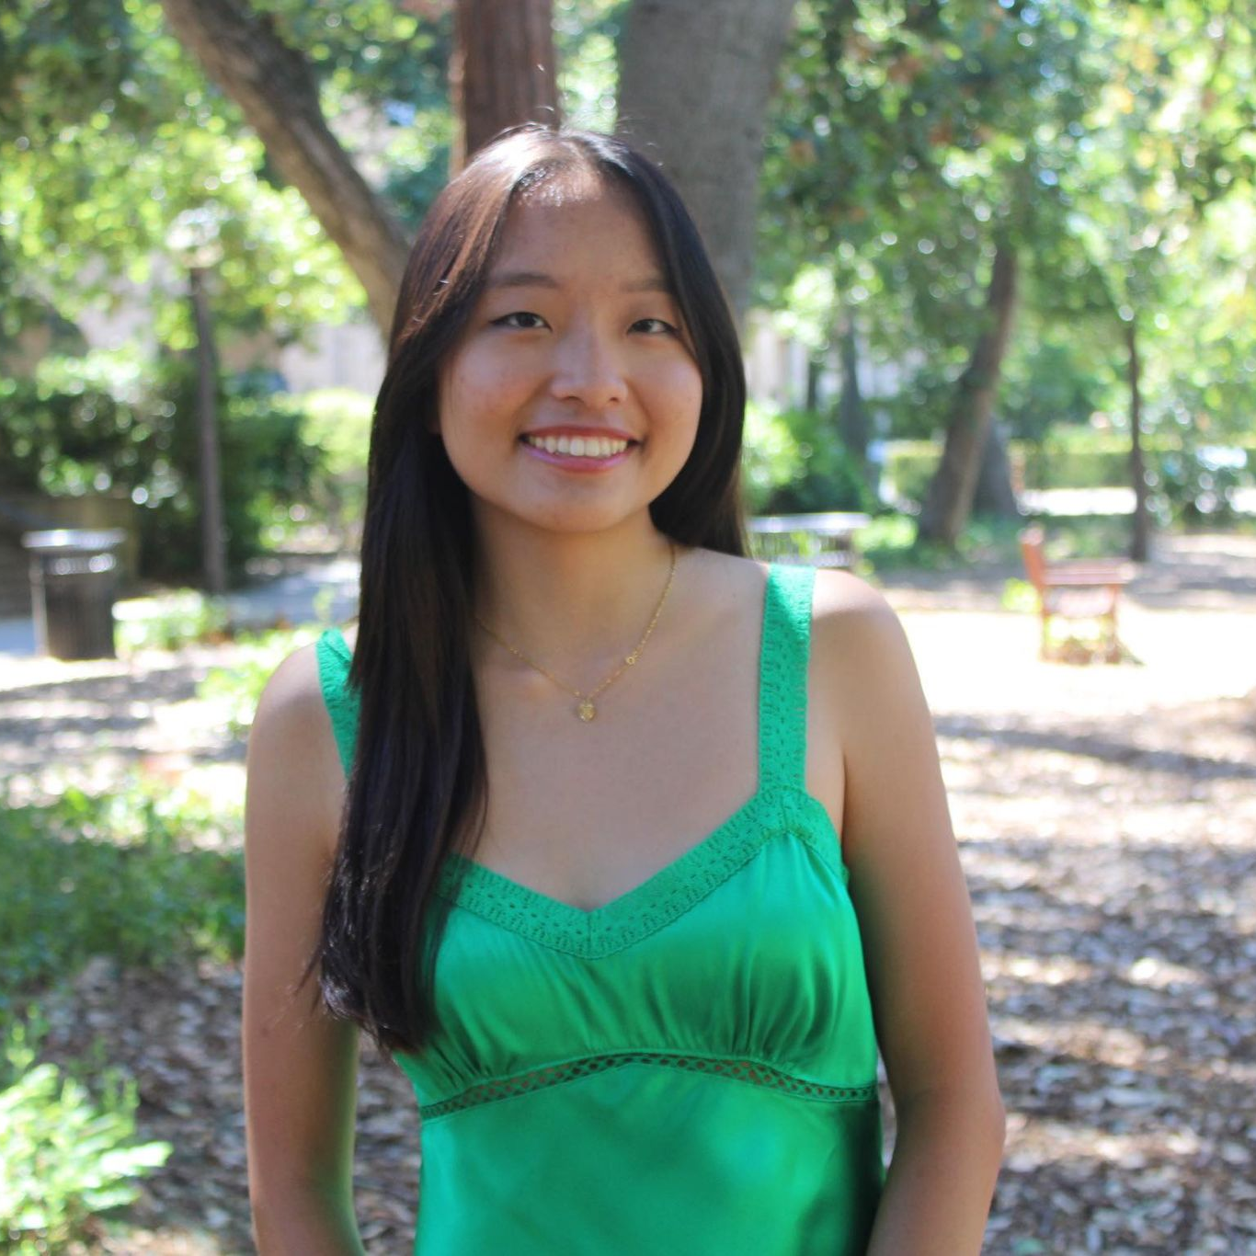

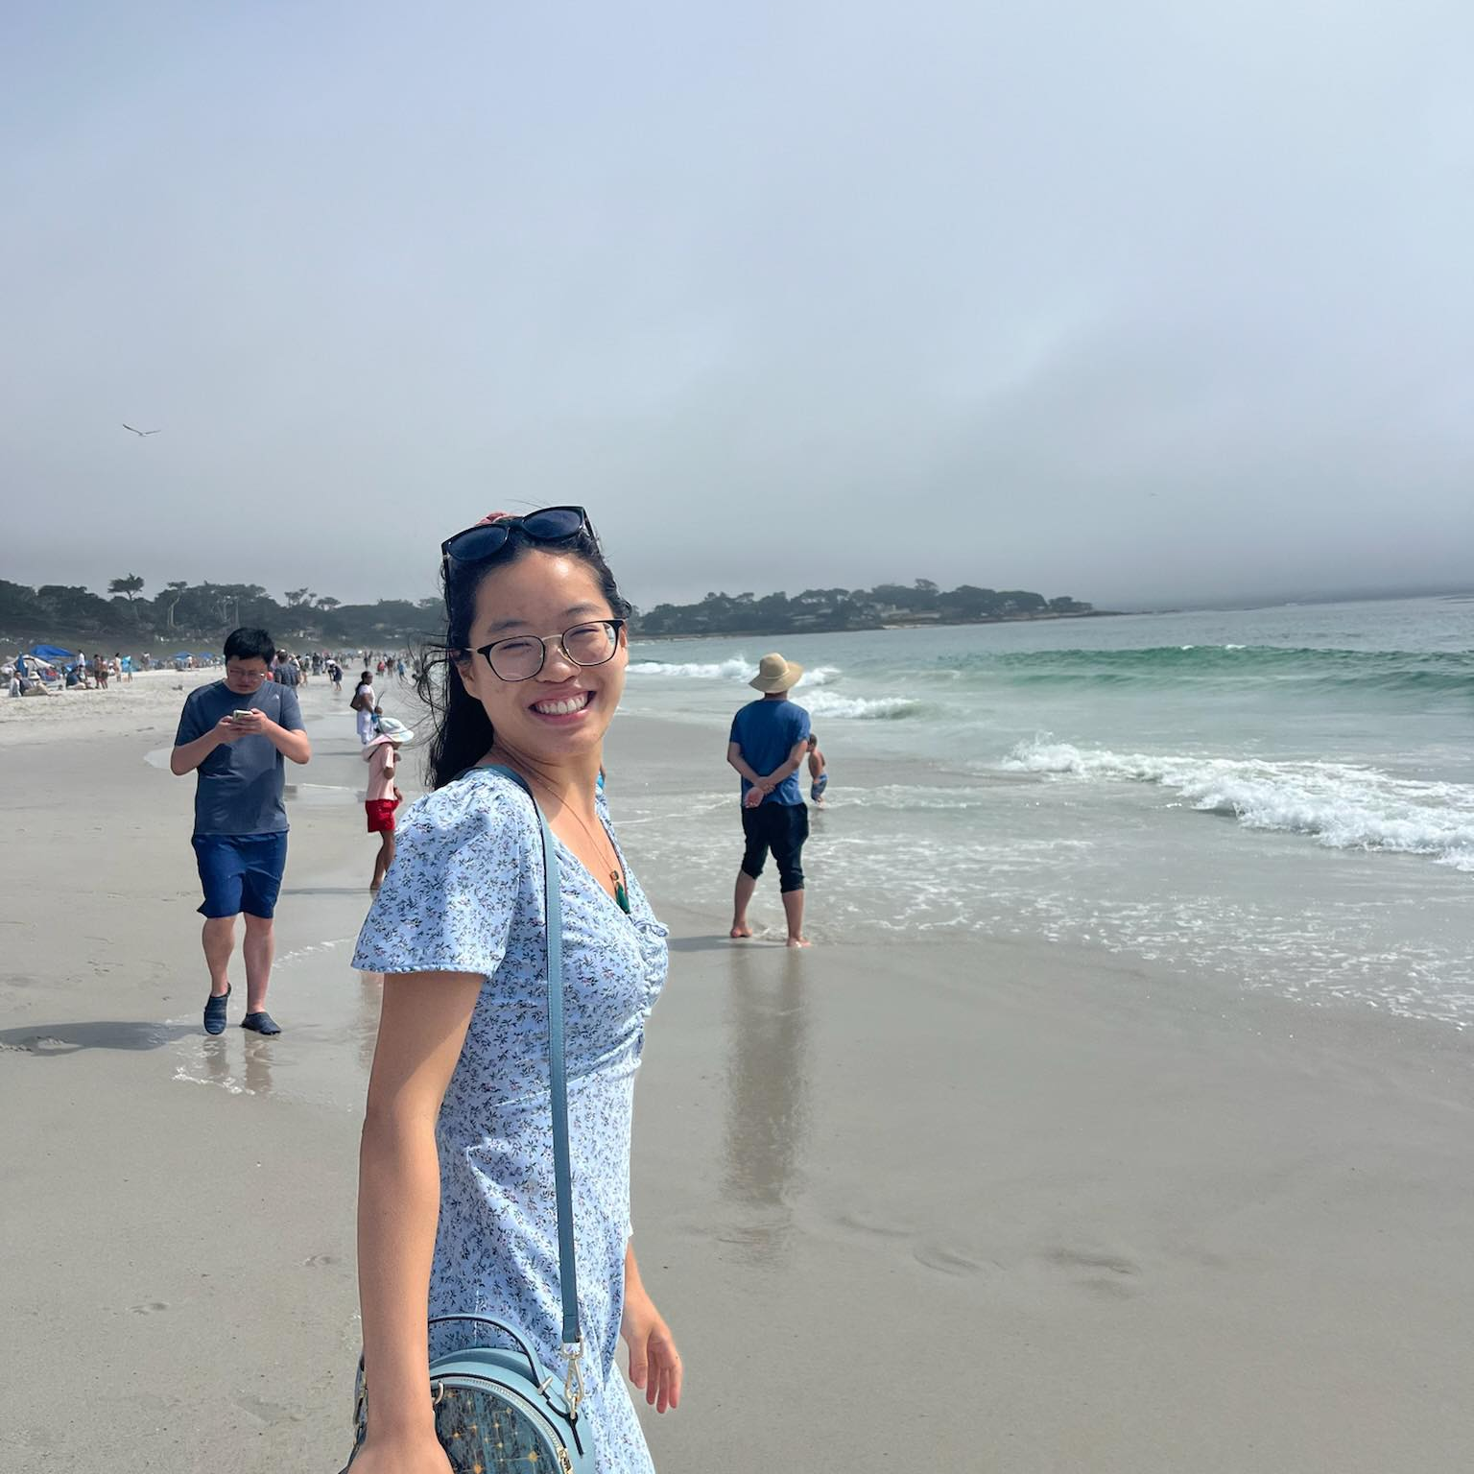
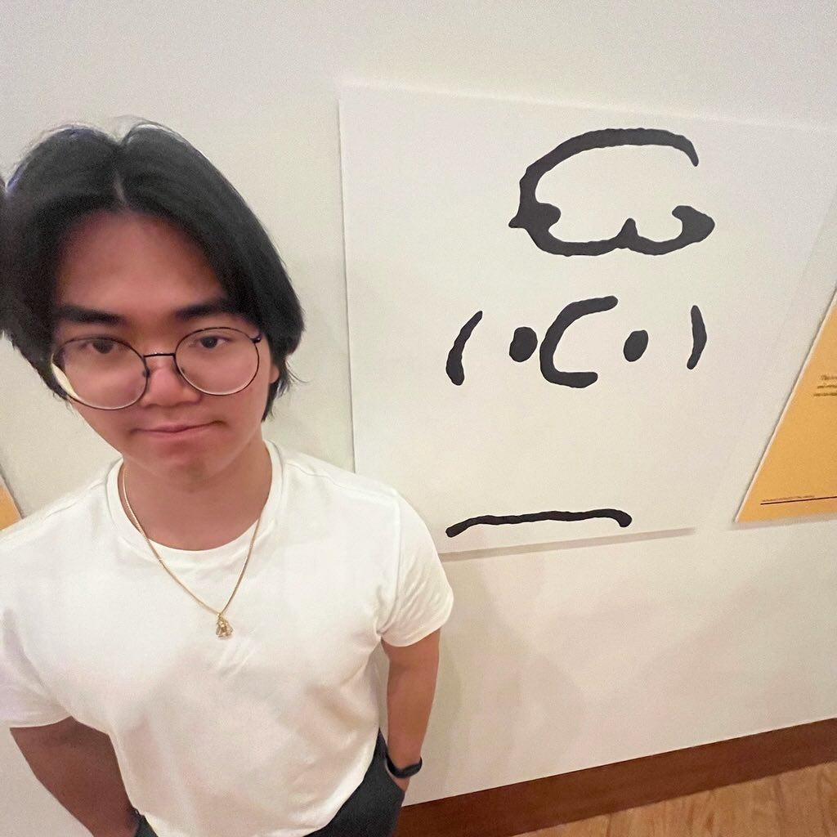
Meet the Team!
Felicia Yan
Myan Ngo
Sunny Yu
Thu Le
Sophomore
CS (HCI)
Junior
CS (HCI)
Junior
SymSys (CogSci)
Junior
CS (HCI)

Slide 3
Domain Selection
Emotional Wellness
Stress Management
Relationships / Life

Slide 4
Main Questions
How do people manage their emotional wellbeing?
Where does mental health care fit into people’s daily routines or thinking patterns?

Slide 5
Needfinding Methodology
Wanted to interview a diverse group of people
  non-Stanford, various age, race, gender
Interviewed at Town & Country and Stanford
Everyone interacts with mental health → no target
  Note: only people comfortable with talking about mental health responded
One person interview, other takes notes

Slide 6
Interviewees
“Amy”
“Max”
“James”
“Tracy”
50 years old, CFO of public company
29 years old, Software Engineer
71 years old, Retired (former retail manager)
21 years old, Stanford Student

Slide 7
Extreme Users
“James”
“Amy”
“Tracy”
Going Through Lots of Grief
Very Positive
Notes:
James - got diagnosed with illness, amy - lost her sister
Tracy - describes herself as a happy person

Slide 8
Questions Asked
Why do you get stressed? What plays a factor?
How do you usually deal with stress? Can you describe a time when you faced a stressful situation and how you handled it?
How has approaching mental health changed for you at different ages and/or stages of your life?
Is there anything you wish you could talk more about with people in your life?
Can you give an example of how technology fits into your life in terms of managing your emotions or stress?
Notes:
Include the thread

Slide 9
Empathy Maps
SAY, DO → THINK, FEEL

Slide 10
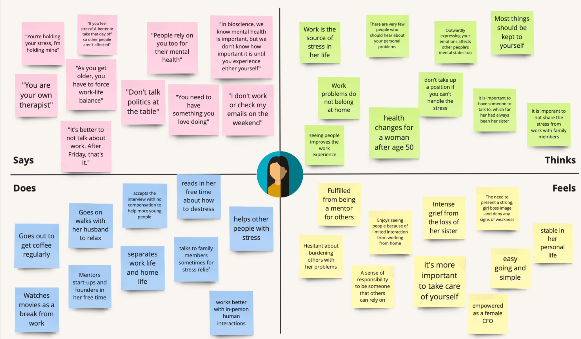
“Amy”

Slide 11
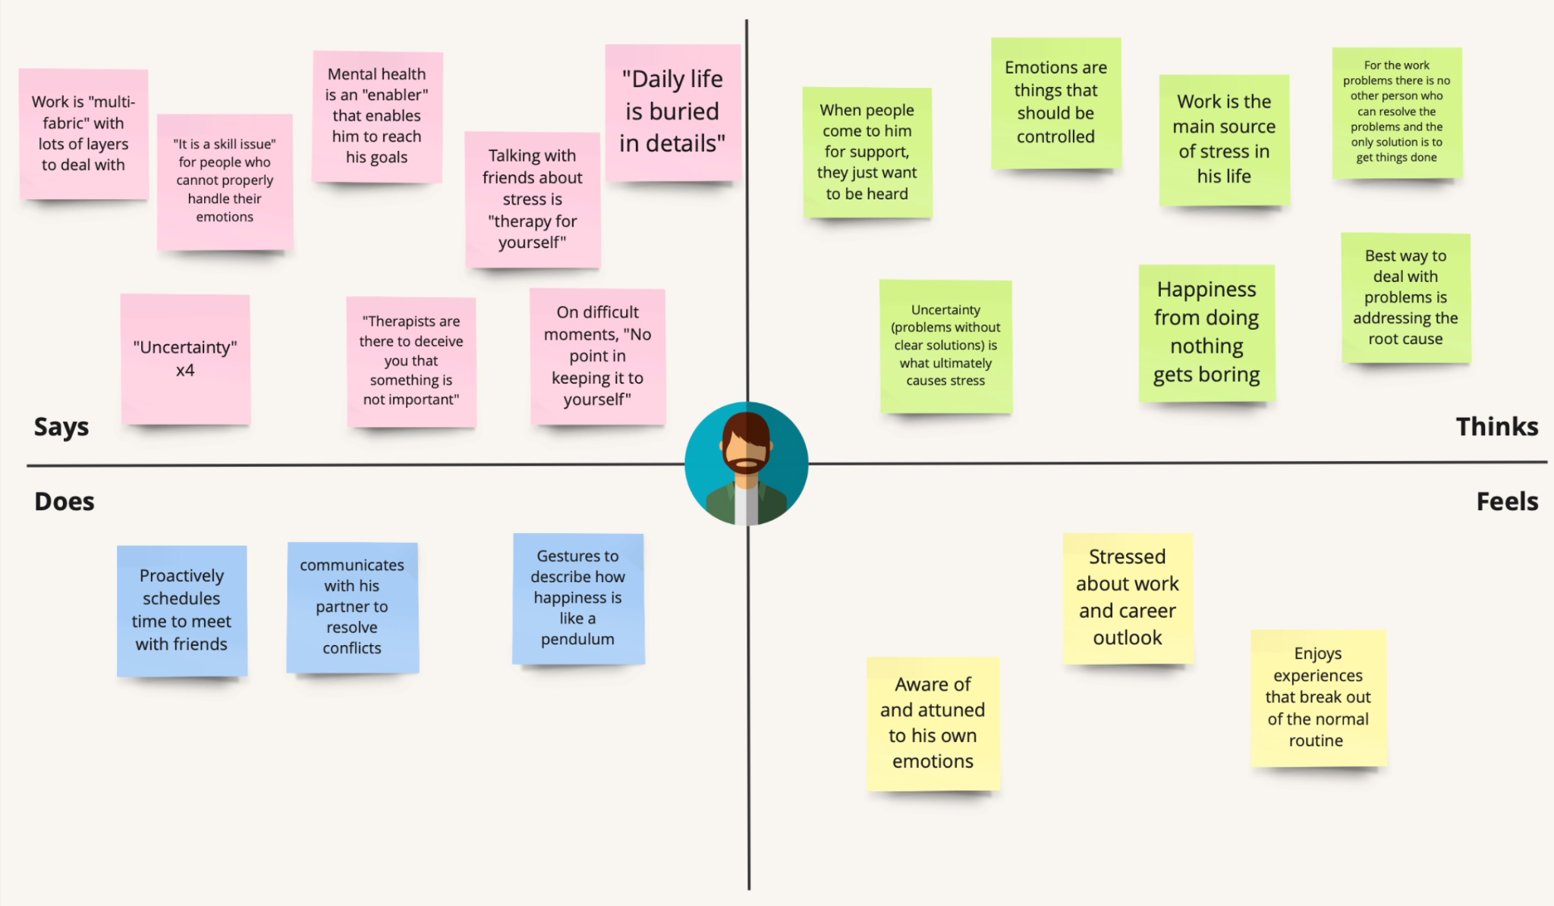
“Max”

Slide 12
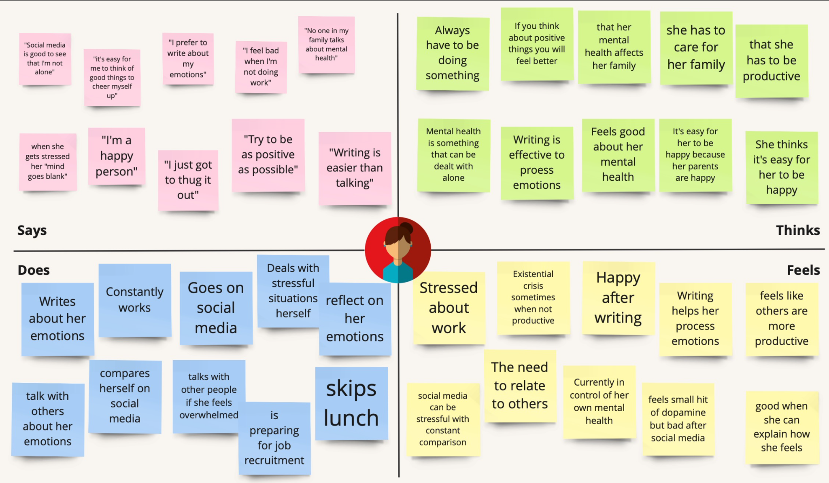
“Tracy”

Slide 13
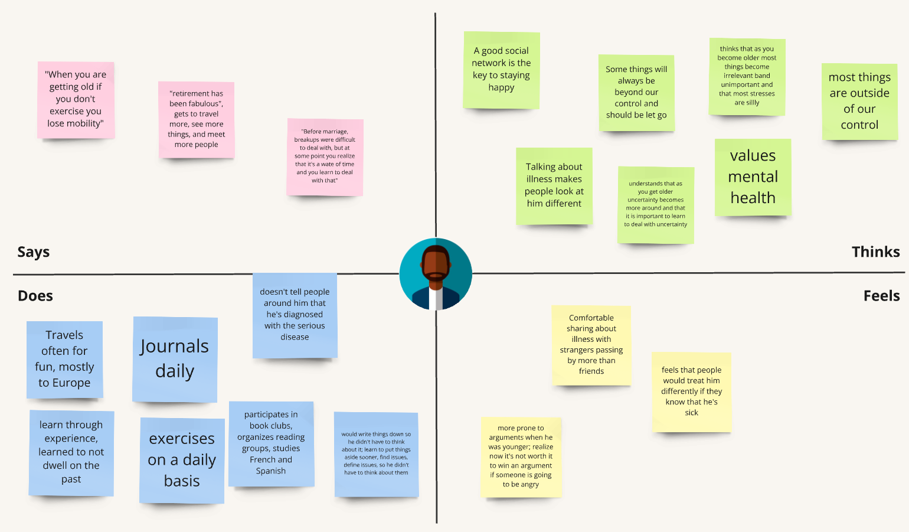
“James”

Slide 14
—”Amy”
“It’s important to take care of yourself, as you are your own therapist“

Slide 15
Key Findings
All very different stages of their life – but all still experience sadness to a degree and feel the need to confide with others
  Need to have a place to channel thoughts/emotions
Easier to express vulnerability anonymously (no judgement zone)
Everyone has very different emotional needs
What’s next?
Focus on a specific aspect of mental health
  Focus on specific demographic
Explore ways to unify all these different mental health needs
  Categorize needs
Even more extreme user

Slide 16
Thanks for Listening!

