Slide 1
Collabrio Medium-Fi Prototype
Alexander, Armita, Cate, and Manas

Slide 2
Value Proposition
A platform where an employer’s network is used and expanded to match them with freelance collaborators for long-term project partnerships.

Slide 3
Problem & Solution
Problem: It is very hard to find people outside of one’s typical network when you have a specific need for a niche project
Primary User: Freelancers
Solution: Collabrio aims to connect people with those outside of their typical network in order to work on collaborative projects, find others with unique niches, and form and maintain professional relationships

Slide 4
Values in Design
Simplicity
Inclusivity
Portfolios are centered with large photos
Tags make it easy to sort
Use of standard icons to reduce clutter
Text is minimized without being hard to understand
Tension: removing extra content makes it difficult to show the full scope of someone’s work
Accessible design
  Text contrasts with background
  Buttons are large, bright, and easy to locate
Connections tree highlights new connections to mitigate continuing inequities in the target industry
Tension: connections tree builds on existing network to make users more comfortable building a network in the first place.
Tension between values: simplicity may reduce the functionality of extreme users that require more personalization of their work, making it less inclusive.

Slide 5
Simple Task
Find someone from your extended network for a specific project
No change from A5

Slide 6
Moderate Task
Share the project you worked on and connect it to a new tag
No change from A5

Slide 7
Complex Task
Update your portfolio with AI
Changed to “update” rather than “organize” and removed “and profile” to reflect changing functionality that only pulls new data from external sources.

Slide 8
Usability Goals & Key Metrics
Efficient
Intuitive
Key Measurement: time spent to complete a task
Key Measurement: # of mis-clicks while completing a task

Slide 9
Initial Assessment of Usability Goals
Based on our Low-Fi Prototyping results
Intuitive = low # of mis-clicks
Efficient = low amount of time spent
Users did not find it intuitive to view their visual network or contact someone in their connection
Users were not efficient and did not find it intuitive to navigate the task of adding a new project
Users were not efficient and did not find it intuitive to identify and utilize our AI functionalities

Slide 10
Progress on Usability Goals
Efficient
Intuitive
Reduced number of pages to edit your profile, both manually and with AI
Streamlined functional flow for adding a project (reduction of steps)
Restructured visual display for important buttons used to view and contact a user’s connections
Restructured visual display and functional flow for adding a project

Slide 11
Change 1:
Used Gestalt Principles to draw attention to the “contact” and “mutual connections” buttons
HOW IT PROGRESSES GOALS
Progresses Intuitive goal by reorganizing these buttons, clarifying their purpose. This reduces the number of mis-clicks, helping users complete their tasks without feeling lost or missing key features.
RATIONALE
In our low-fi testing, users did not click on either of these buttons. The connect button is the main actionable step a user can take from another person’s profile page, so we separated it. We also moved the mutuals button near the degrees away so it was clearer what it meant.

Slide 12
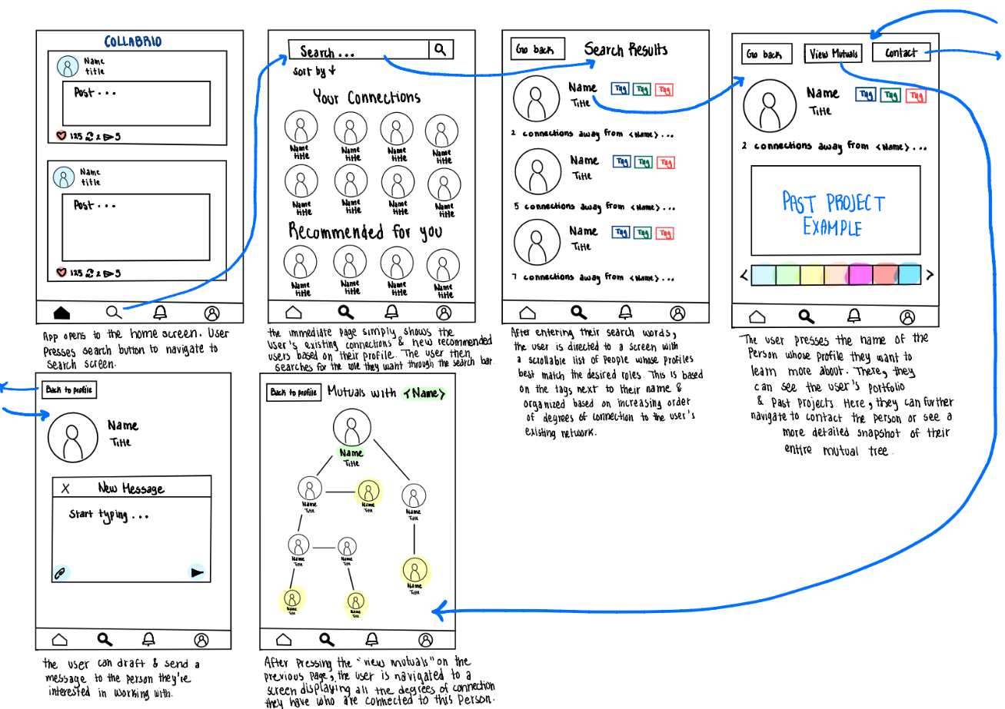
Before

Slide 13
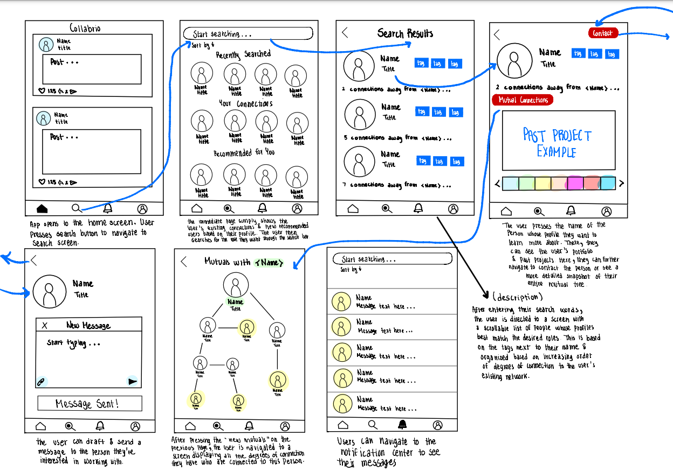
After
Contact button was separated, search page is less dense, changed label of “mutual connections” button and moved it.

Slide 14
Change 2:
To add a project, you can (only) go directly from the my profile screen, without any extra screens in between.
HOW IT PROGRESSES GOALS
Progresses Efficiency goal by lowering the number of steps, allowing users to to perform a core task quicker and Intuitive goal by more clearly exposing this part of the task flow visually and functionally
RATIONALE
In our prototyping, it took users a long time to figure out where the add button was. Further, the portfolio only screen and the notifications screen were essentially never used, and we found that they weren’t logical ways to find the add button. In general, there likely was no need for a portfolio-only view.

Slide 15
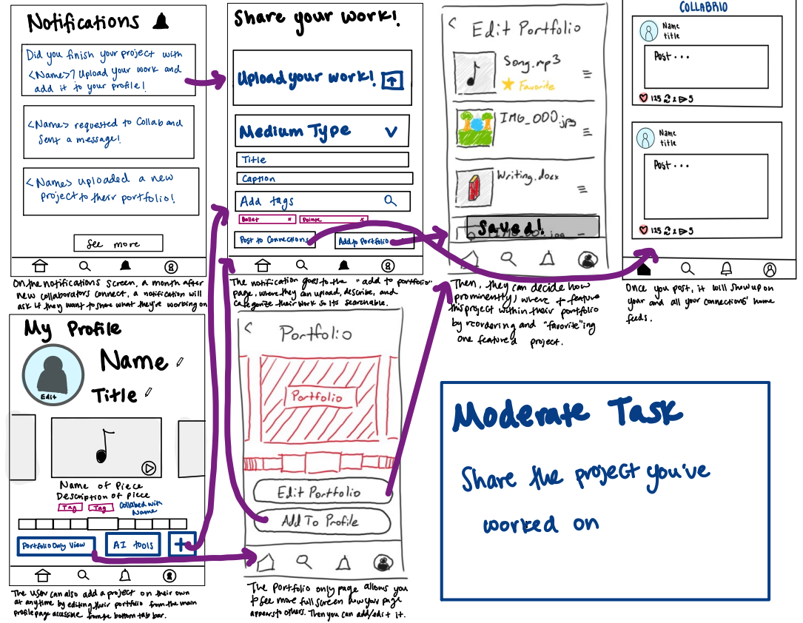
Before

Slide 16
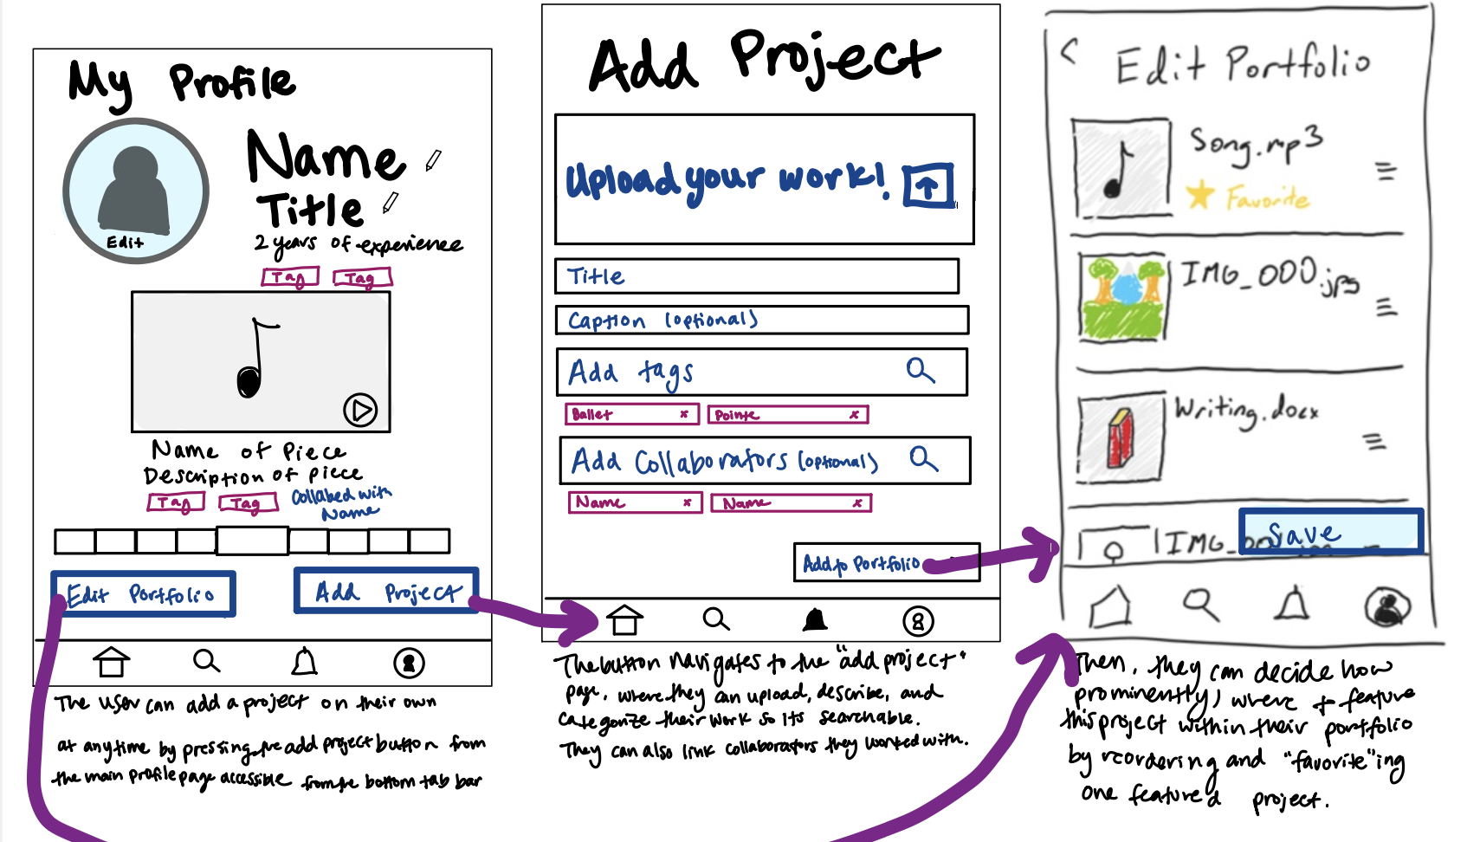
After
Portfolio-only view removed, AI tools moved off of my profile page, collaborators added, medium type removed, posts are now automatic so you have to save.

Slide 17
Change 3:
AI is used to generate or update a portfolio using other resources (not to organize your portfolio).
HOW IT PROGRESSES GOALS
Makes the task more Intuitive by clarifying purpose with keywords “update” and “sync to portfolio.” Makes it Efficient by removing extra pages and buttons that did not add to functionality.
RATIONALE
Our testers were confused about the purpose of our AI tools, and when was appropriated to use them. They were unsure of if their resume and website were hosted on the platform and asked us what the effects of the AI tools themselves would be.

Slide 18
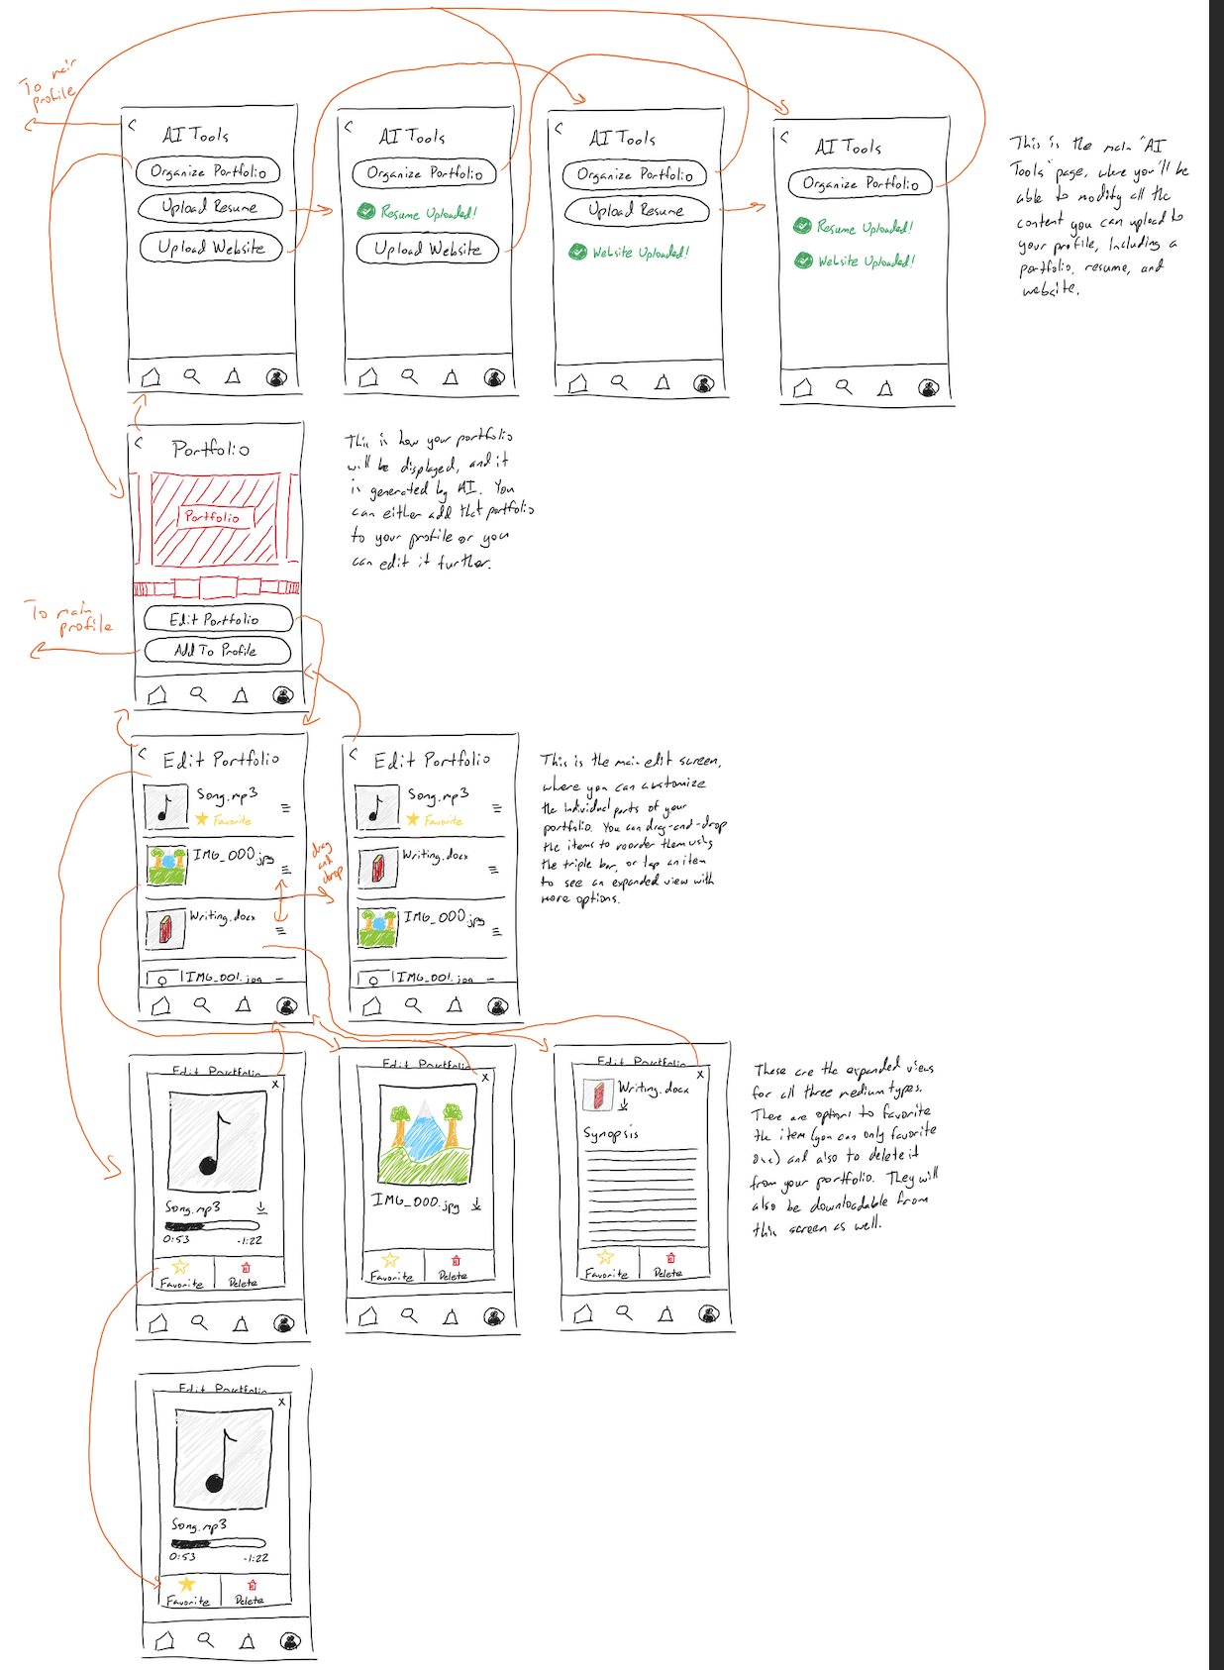
Before

Slide 19
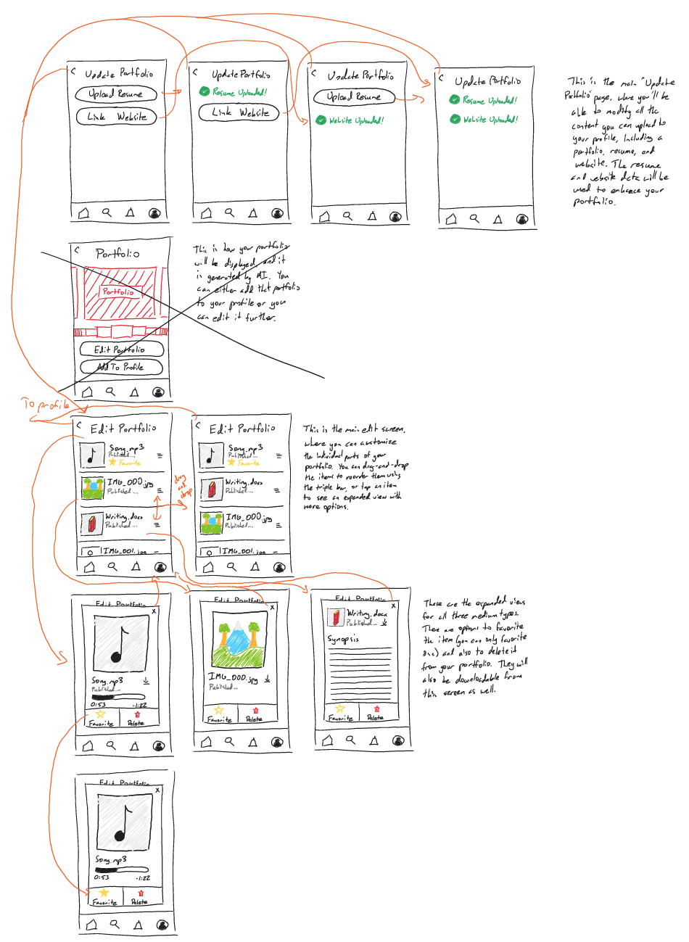
After
Removed the “organize portfolio” button and removed the portfolio-only view.

Slide 20
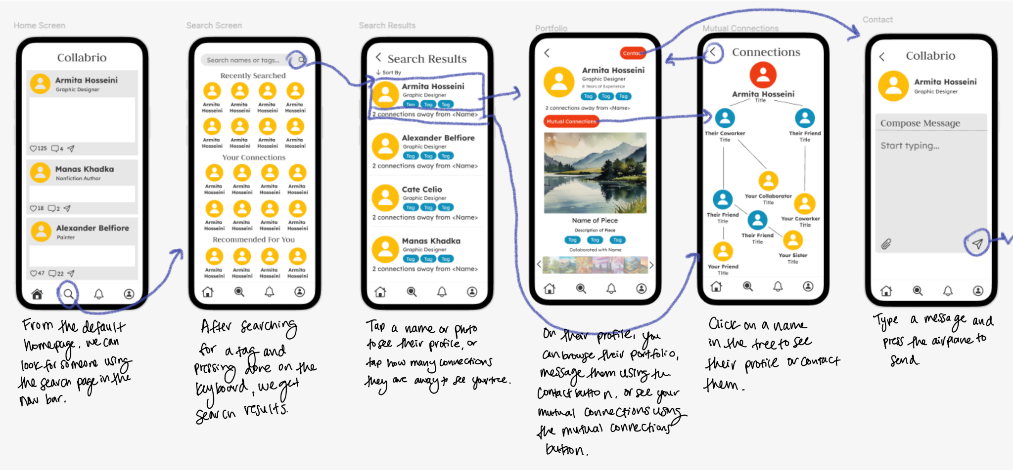
Medium-Fi Simple Task Flow

Slide 21
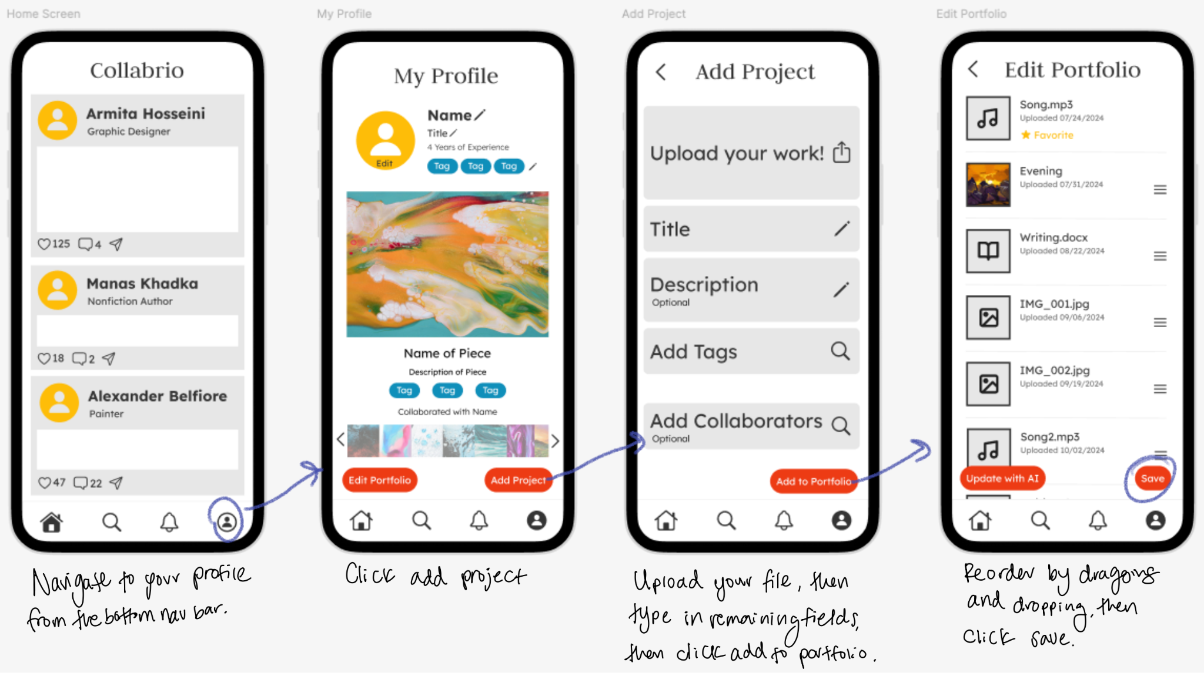
Medium-Fi Moderate Task Flow

Slide 22
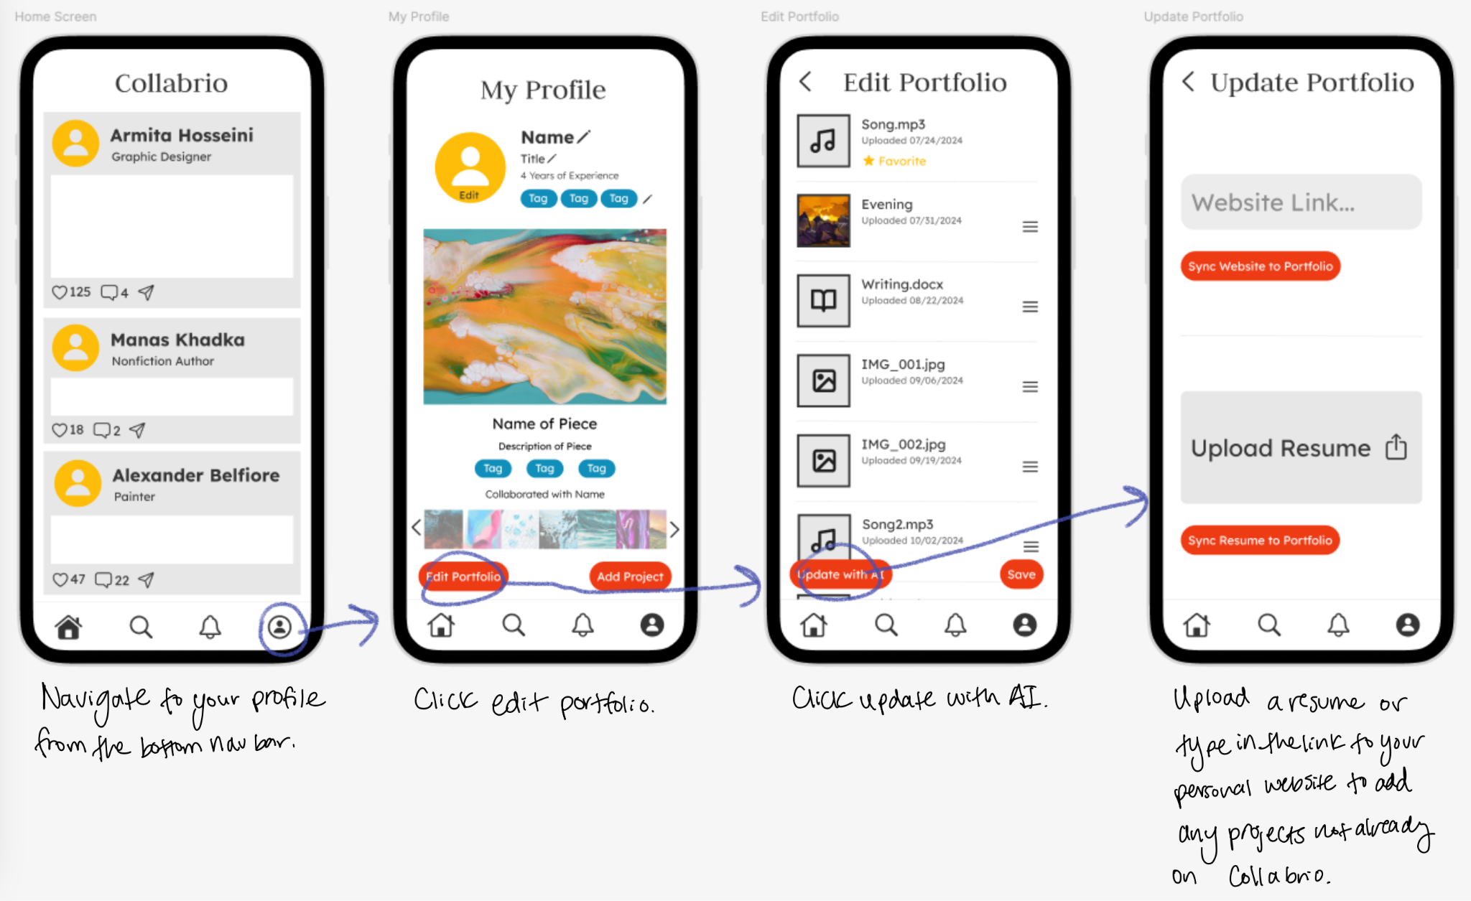
Medium-Fi Complex Task Flow

Slide 23
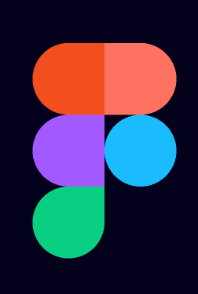
Tools: Figma
We used Figma for designing and prototyping.
Pros:
Easy to format
Easy to collaborate and share finished prototype
Clickable buttons that navigate to desired screens
Cons:
Transition functionality is limited (can’t have one click trigger multiple changes)
Doesn’t track screen history for back buttons
Steep learning curve as beginners

Slide 24
Tools: SF Symbols
Tools: Unsplash
We used SF Symbols Browser for icons.
Pros:
Easy to change size and color
Large variety of options
Cons:
Difficult to download for non-Mac so only some team members could access
We used Unsplash for images.
Pros:
Images of almost every type
Easy to find images of what you are looking for
Cons:
Reformatting was not always intuitive, especially if matching with icons

Slide 25
Limitations
Keyboard input not supported across prototype: It is virtually impossible to implement this level of functionality on Figma, since a new screen must be created for each individual input
Not all files are editable: Only the Song.mp3, IMG_000.jpg, Writing.docx files are editable; making all the others editable would require additional work that doesn’t add to the prototype
Pop-ups disable prototype functionality: An odd feature/bug of Figma is that whenever an overlapping element exists on the screen, the user is unable to interact with the background
Pages are not scrollable: Implementing scrolling on Figma is somewhat difficult and doesn’t add to the prototype

Slide 26
Hardcoded & Wizard-of-Oz features
User-input for searching is not needed. Instead the user is instantly sent to a search results page
The page displaying a visual network view of a user’s mutual connections network is hardcoded
User profile data is pre-set, such as previous projects and some media files
User-input for editing the profile is not needed. Instead, when the user selects “edit”, a hardcoded edit occurs
Search results page using our hardcoded user-input for the search query

Slide 27
Prototype Link

Slide 28
Appendix

Slide 29
Full Simple Task Flow Changes
Changed search screen to include recently searched users rather than only your past collaborators
Moved “sort by” on search default page to the search results page
Made “contact” button more prominent by separating it from the rest of the profile
Made “view mutuals” button more logical and prominent by changing text to “mutual connections” and placing it adjacent to the line describing how far they are from your network

Slide 30
Full Moderate Task Flow Changes
Removed unnecessary pages like “organize portfolio” before the edit page
Changed buttons to “edit portfolio” to reorder existing files, and expanded the plus sign button to clarify with “add project”
Removed medium type dropdown, instead after uploading a file the app will auto-detect file type
Added optional collaborators field
Made description/caption field optional for new projects
Automatically sharing any added projects to the feed, thus removing the post to connections button that prevented saving

Slide 31
Full Complex Task Flow Changes
Clarified that AI will be used to generate or update a portfolio using other resources such as a personal website or a resume
Changed “upload website” button to “link personal website” to clarify that it’s not hosted on our app
Possible extension to build sub-categories with “mini portfolios” featuring specific aspects of a freelancer’s work

