Slide 1
Team 2: Needfinding
Manas, Armita, Alex, Cate

Slide 2
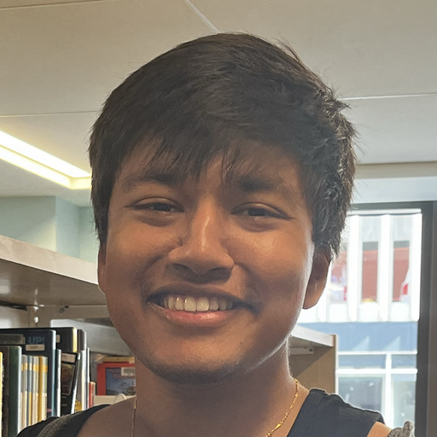
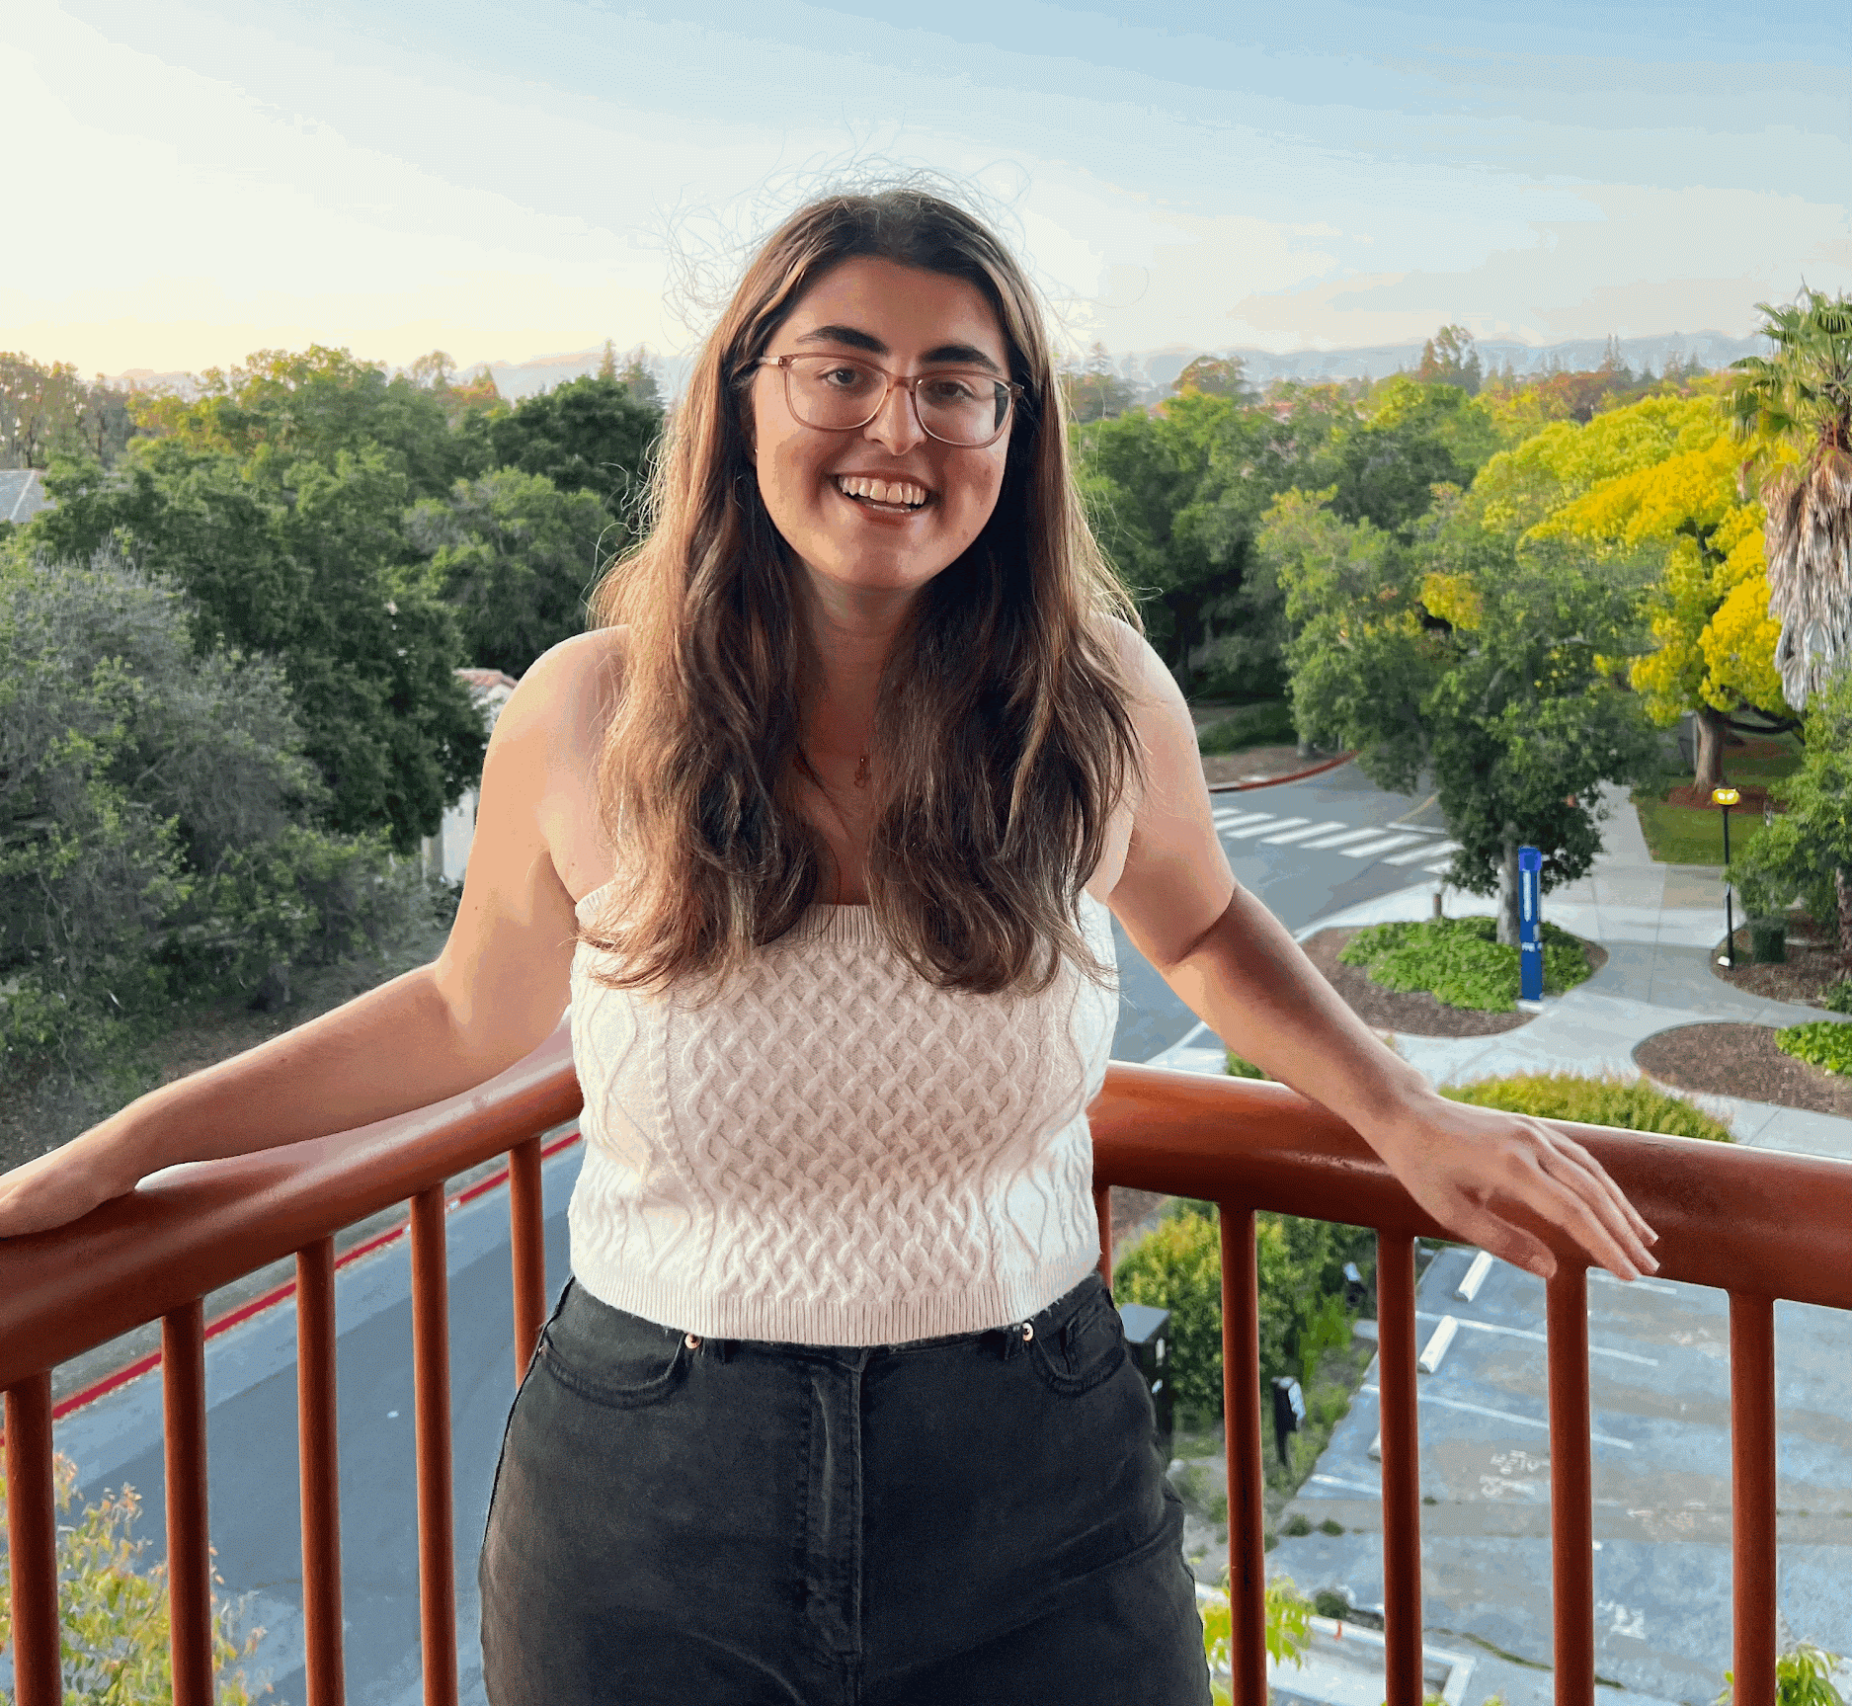

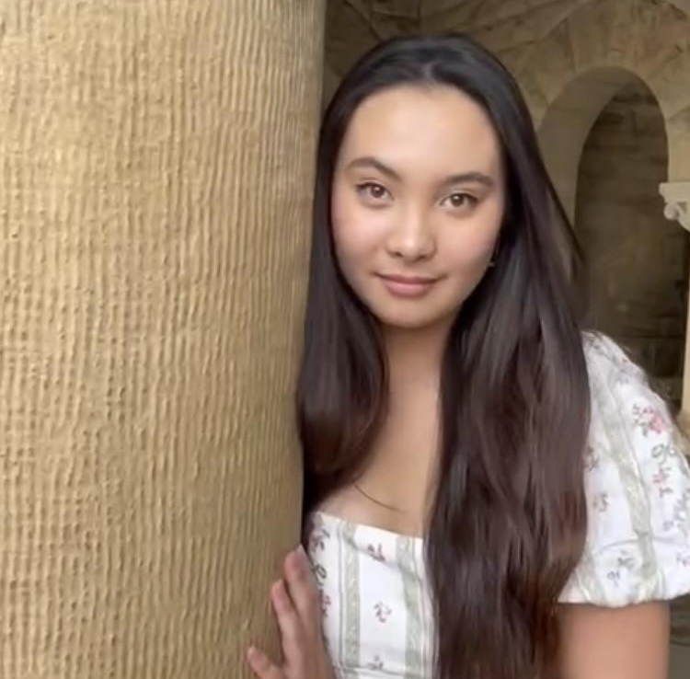
Meet the team
Manas
Khadka
Armita Hosseini
Alexander Belfiore
Cate Celio

Slide 3

Problem Domain
How do people navigate entering / changing fields in their professional lives?
What types of social channels do they use for this?
It’s commonly seen as stressful and a hassle - is this actually true and if so, why???
What is ‘success’ in this space for different people?

Slide 4
Who We Interviewed:
Name | Sammy | Regina | Hannah
Occupation | Lawyer | Pre-medical Student | Freelance Artist / Journalist
Int. Location | Boba Shop | Zoom | Living Room
Description | Previously worked in tech sales for startups Recently transitioned into a lawyer position Values important connections and sets networking goals | Experience working with children Research in pathology and neuro Preparing for medical school Considering other options; public health | Works 4 jobs that are temporary in nature Developing skills and connections in theatre production Constantly on the lookout for task-based opportunities Intimate work setting and culture
Notes:
Conducted

Slide 5
What we asked:
Generally…
What do you do? / what are you working towards professionally?
How do you navigate looking for opportunities in your profession?
What are some social aspects to your profession?
Specifically…
Tell me about your journey into law from tech
Why do you struggle more with digital forms of communication professionally?

Slide 6
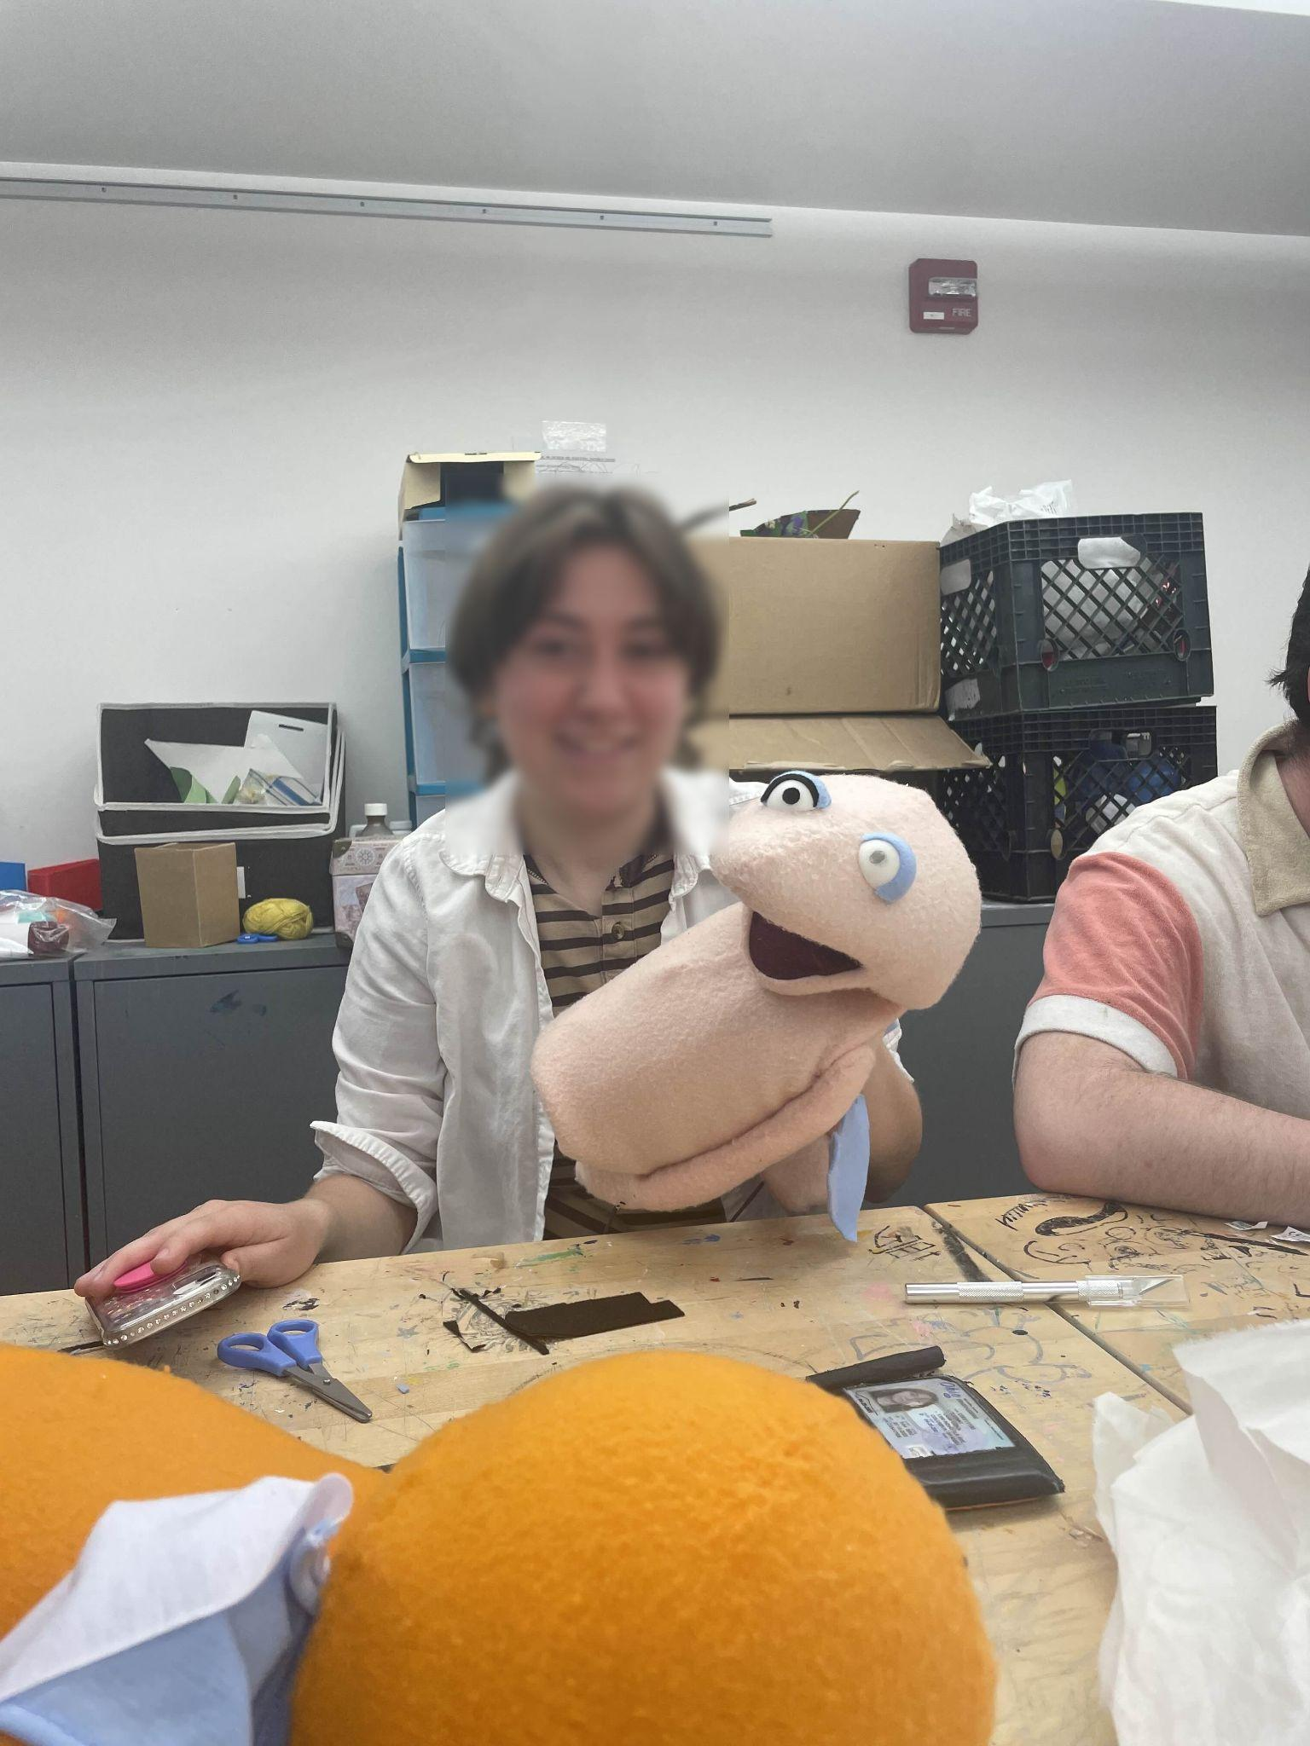
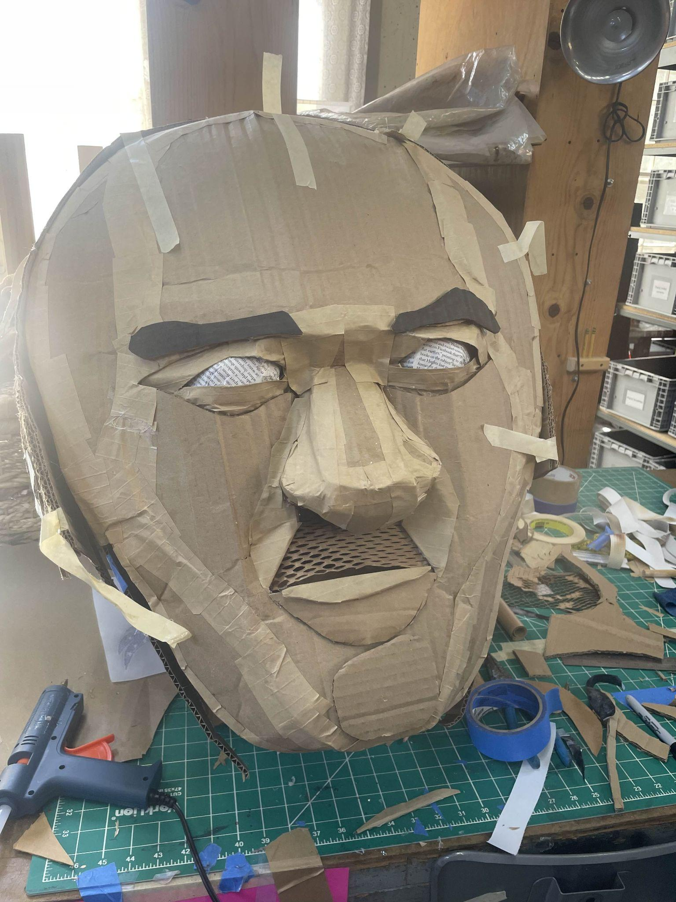
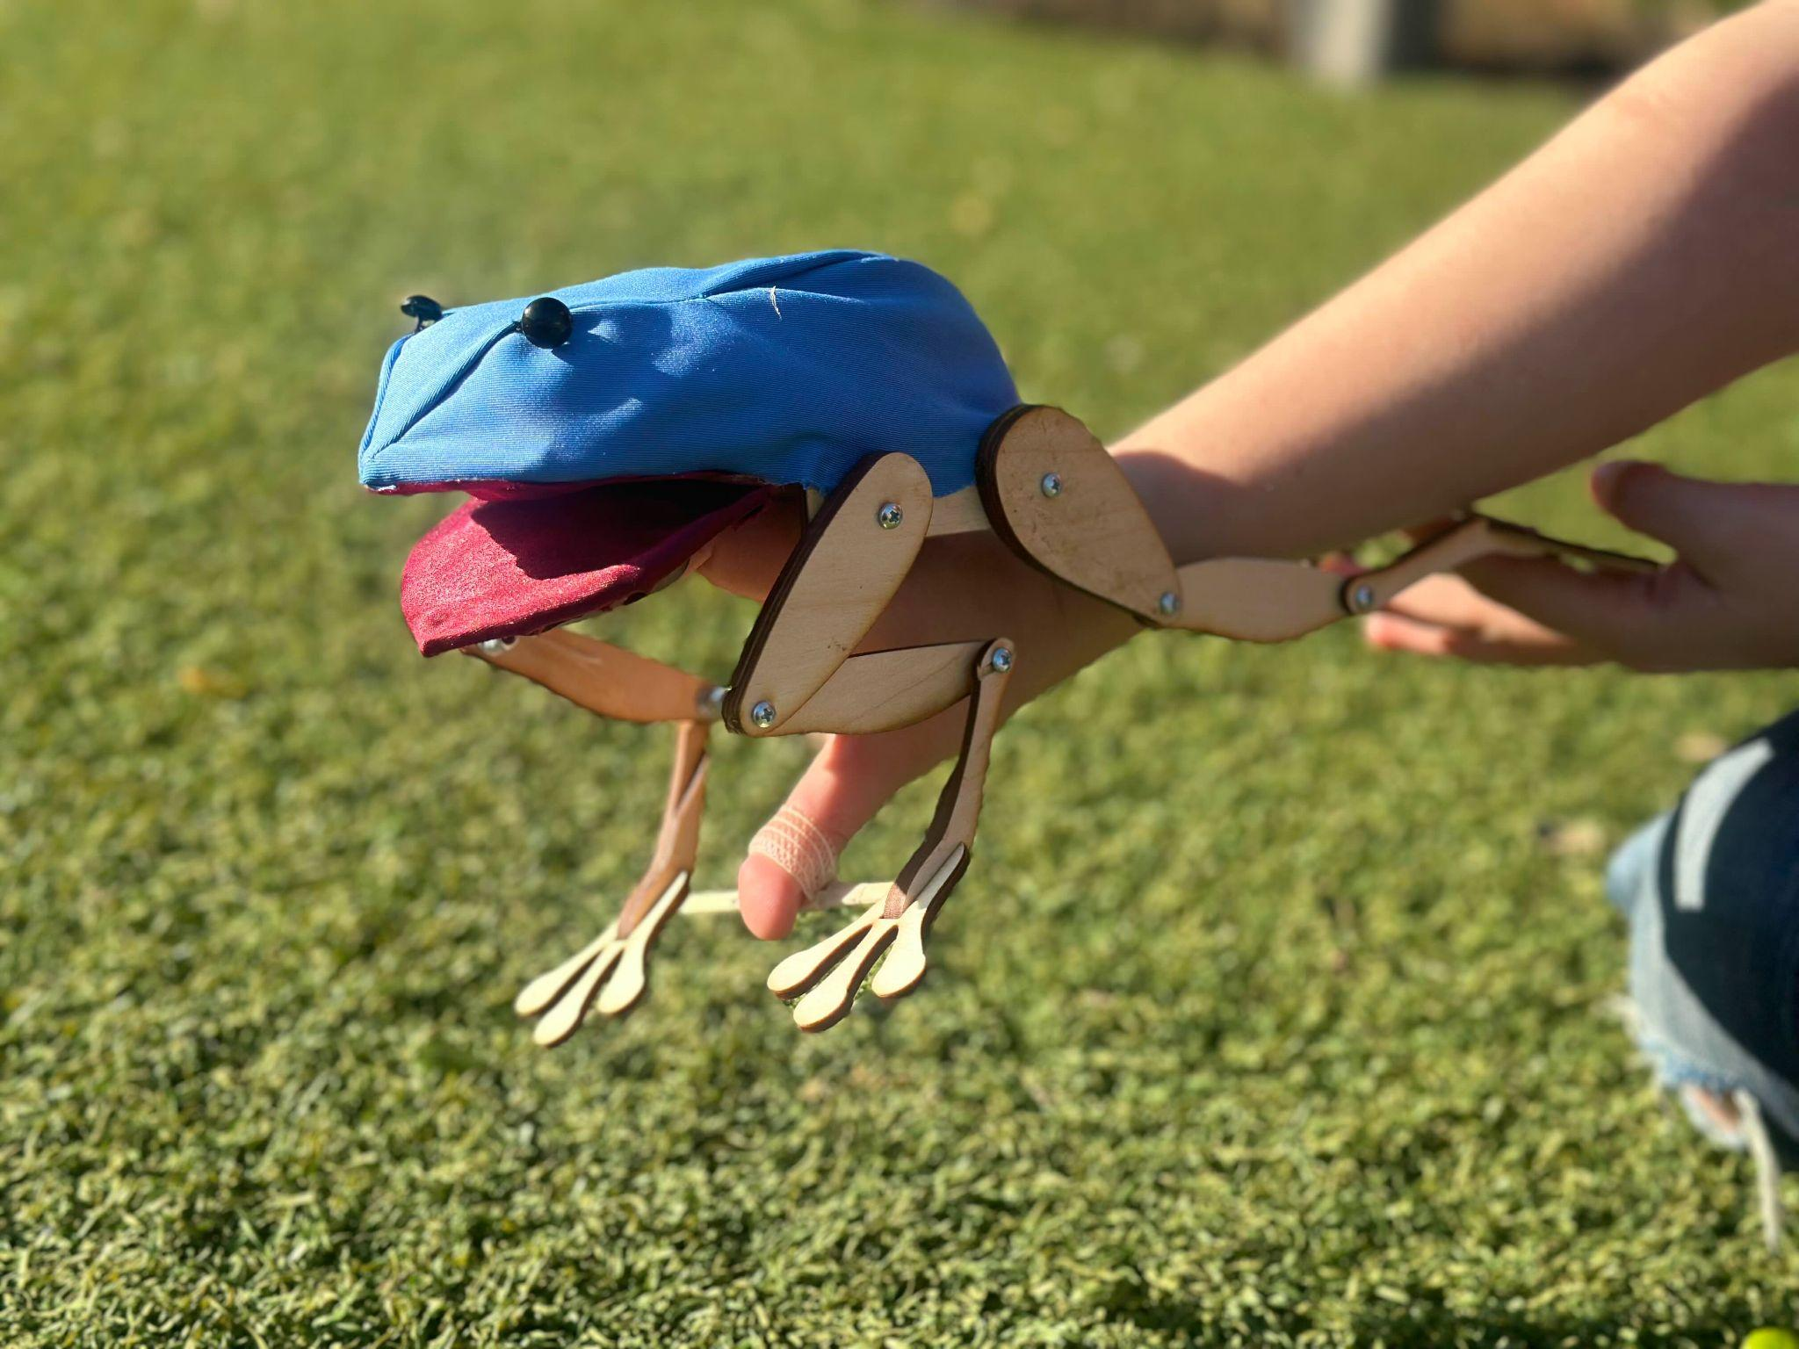
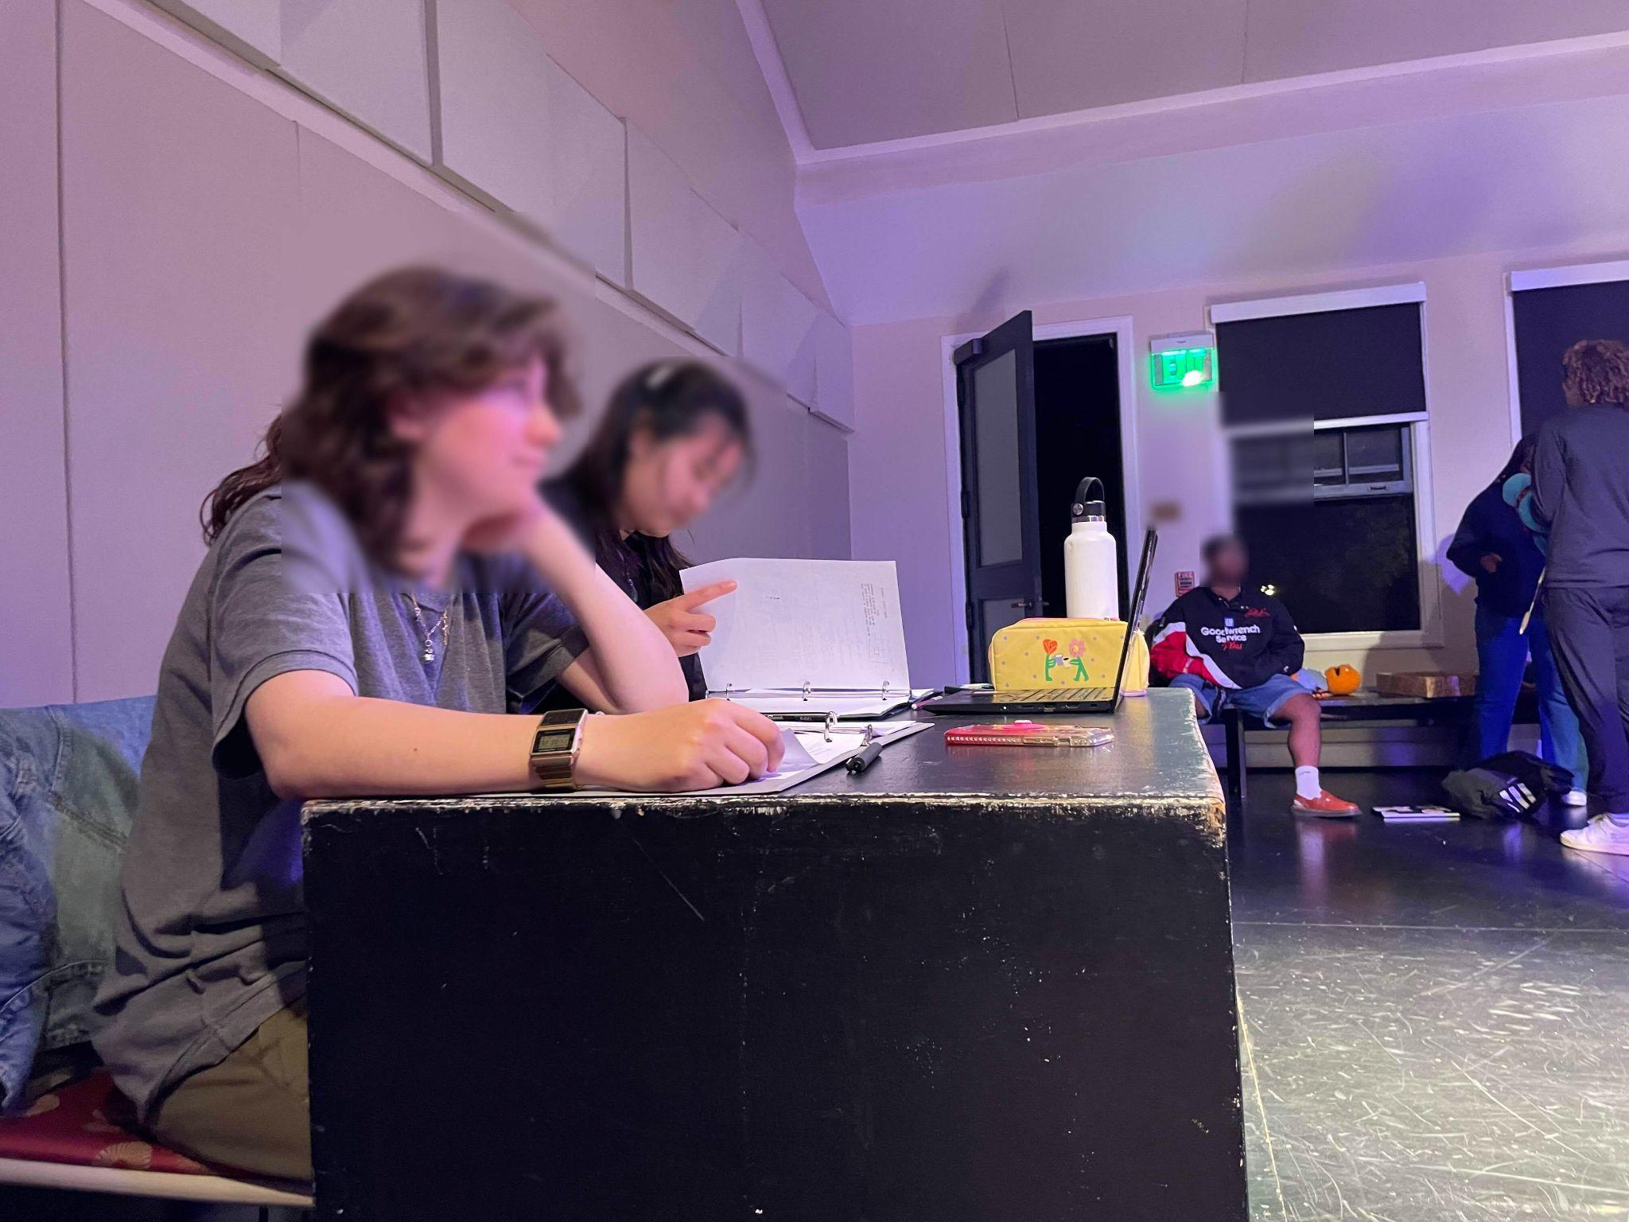
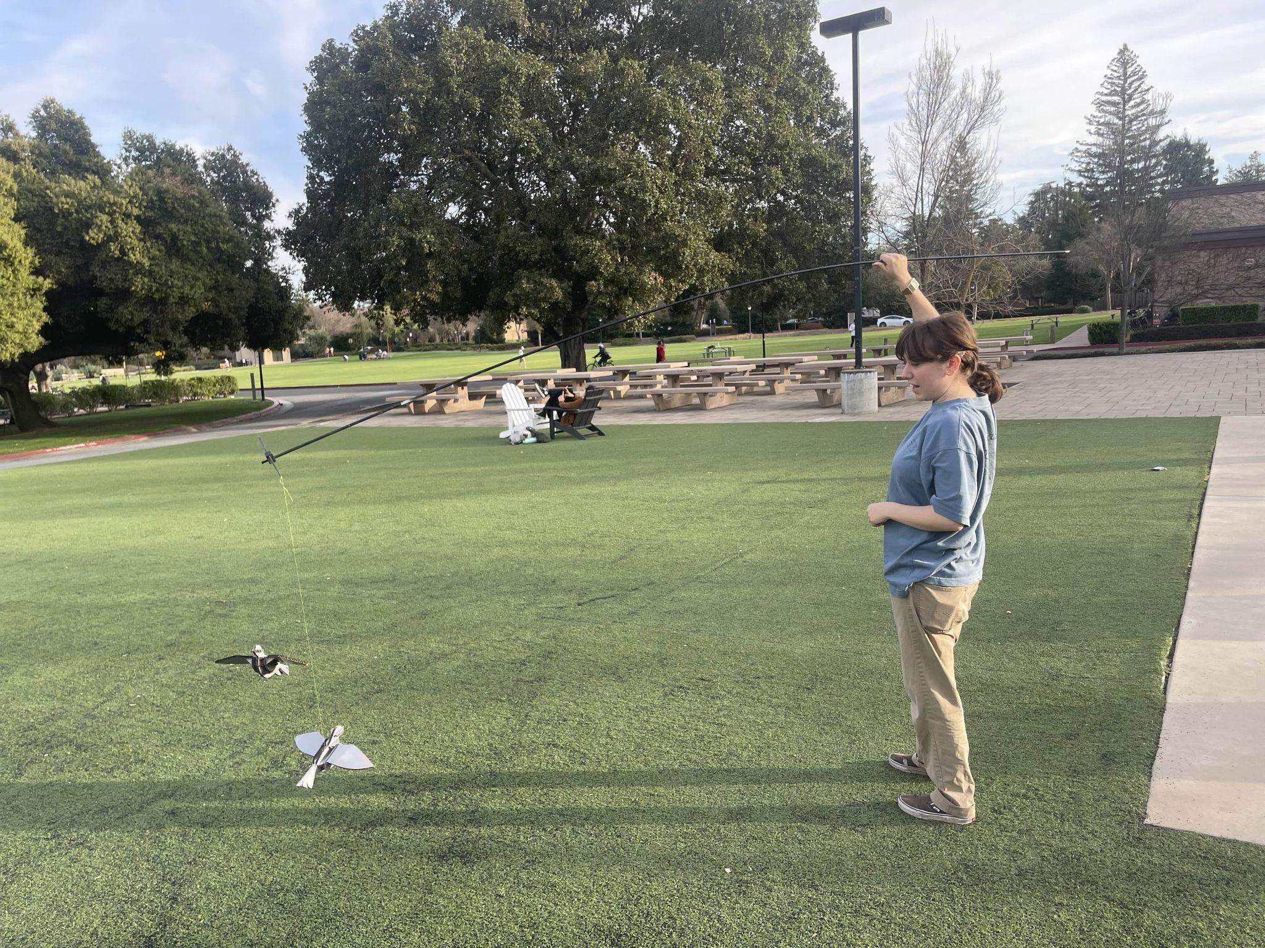
Interview Results: Extreme User Hannah
Notes:
Extreme in that
they are currently at the boundary of many different industries
they socially interface professionally VERY OFTEN across these boundaries

Slide 7
Interview Results - Hannah
Creates a lot of short term plans + goals for her profession
Is constantly thinking:
  What am I going to do next? Who am I going to ask to make it happen
Has a negative emotional response to reaching out to connections through email
  Stressful, therefore averse
“I ask my boyfriend’s dad to help review my professional emails”
“I do not consider my phone a social space”

Slide 8
Interview Results - Sammy
Pushes herself to go out of her comfort zone and meet people who are doing what she wants to do
  Cold Emailing
  Talking to employers after events and career fairs
“It’s my goal to talk to at least 1-2 attorneys from all the most prominent litigation shops in the bay area”
Cares a lot about personal values + aligning it with work
Believes that creating a narrative / elevator pitch based on her strengths helped her find a job that was the best fit for her

Slide 9
Interview Results - Regina
Committed to long-term career prep
Prioritizing
  Education
  Portfolio and skill building
Is developing connections with industry members & profs
Worried about work-life balance and competition in the field

Slide 10
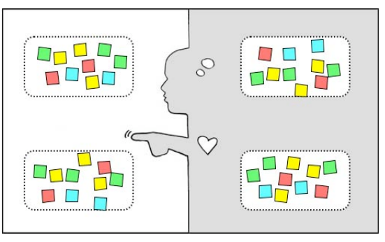
Analysis: Needs & Insights

Slide 11
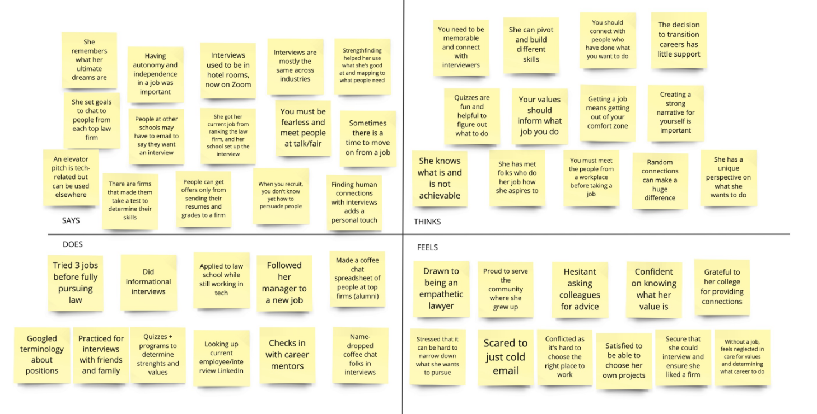
Sammy
Notes:
Rhea’s empathy map

Slide 12
Sammy
Notes:
Sammy’s empathy map

Slide 13
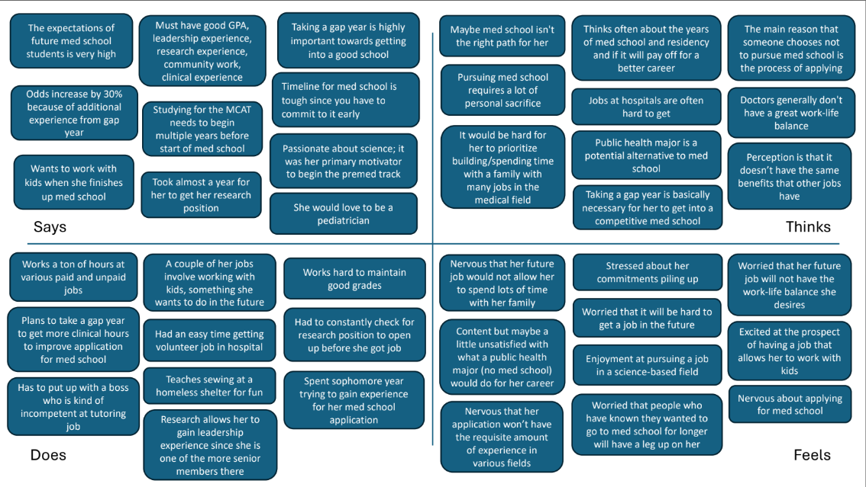
Regina
Notes:
Rhea’s empathy map

Slide 14
Regina
Notes:
Regina’s empathy map

Slide 15
Insights
Professional communication is extremely important and people prioritize that in their professional journeys
Despite a diversity of contexts, preparing for one’s career . . .
  Demands a lot of time
  Can be very stressful
Personal connections were the most important factor
Developing Pattern:
  Hard to cold email, hard to put yourself out there at events
Surprise: Everyone understood what they needed to do professionally

Slide 16
Key Learnings
People get stuck at different parts of navigating professional communication
Even when people understand what they need to do, it is hard to bring themselves to do it
Despite strong beliefs for connecting with humans . . .
  it is hard to cold email or put yourself out there at various events
gaining skills are not as hard as networking

Slide 17
What’s Next
More interviews!
  What about people who are figuring out their goals?
  What about people who DO NOT primarily rely on personal connections?
Explore the narratives of older demographics who are in a transient job situation

