Slide 1
Programming Abstractions
CS106B
Cynthia Lee

Slide 2
Topics du Jour:
  Last time:
    Performance of Fibonacci recursive code
    Look at growth of various functions
      Traveling Salesperson problem
      Problem sizes up to number of Facebook accounts
    Formal mathematical definition
  This time: Big-O performance analysis
    Simplifying Big-O expressions
    Analyzing algorithms/code
      Just a bit for now, but we’ll be applying this to all our algorithms as we encounter them from now on
  Head start on Wednesday’s topic: make your own classes!
    Needed for Boggle assignment, we are starting to see a little bit in MarbleBoard assignment as well.

Slide 3
Translating code to a f(n) model of the performance
 | Statements | Cost
1 | double findAvg ( Vector<int>& grades ){
2 | double sum = 0; | 1
3 | int count = 0; | 1
4 | while ( count < grades.size() ) { | n + 1
5 | sum += grades[count]; | n
6 | count++; | n
7 | }
8 | if ( grades.size() > 0 ) | 1
9 | return sum / grades.size();
10 | else | 1
11 | return 0.0;
12 | }
ALL |  | 3n+5
Do we really care about the +5?
Or the 3 for that matter?

Slide 4
log₂n | n | n log₂n | n² | 2^{n}
2 | 4 | 8 | 16 | 16
3 | 8 | 24 | 64 | 256
4 | 16 | 64 | 256 | 65,536
5 | 32 | 160 | 1,024 | 4,294,967,296
6 | 64 | 384 | 4,096 | 1.84 x 10¹⁹
7 | 128 | 896 | 16,384 | 3.40 x 10³⁸
8 | 256 | 2,048 | 65,536 | 1.16 x 10⁷⁷
9 | 512 | 4,608 | 262,144 | 1.34 x 10¹⁵⁴
10 | 1,024 | 10,240 (.000003s) | 1,048,576 (.0003s) | 1.80 x 10³⁰⁸
30 | 1,300,000,000 | 39000000000 (13s) | 1690000000000000000 (18 years) | 2.3 x 10^{391,338,994}

Slide 5
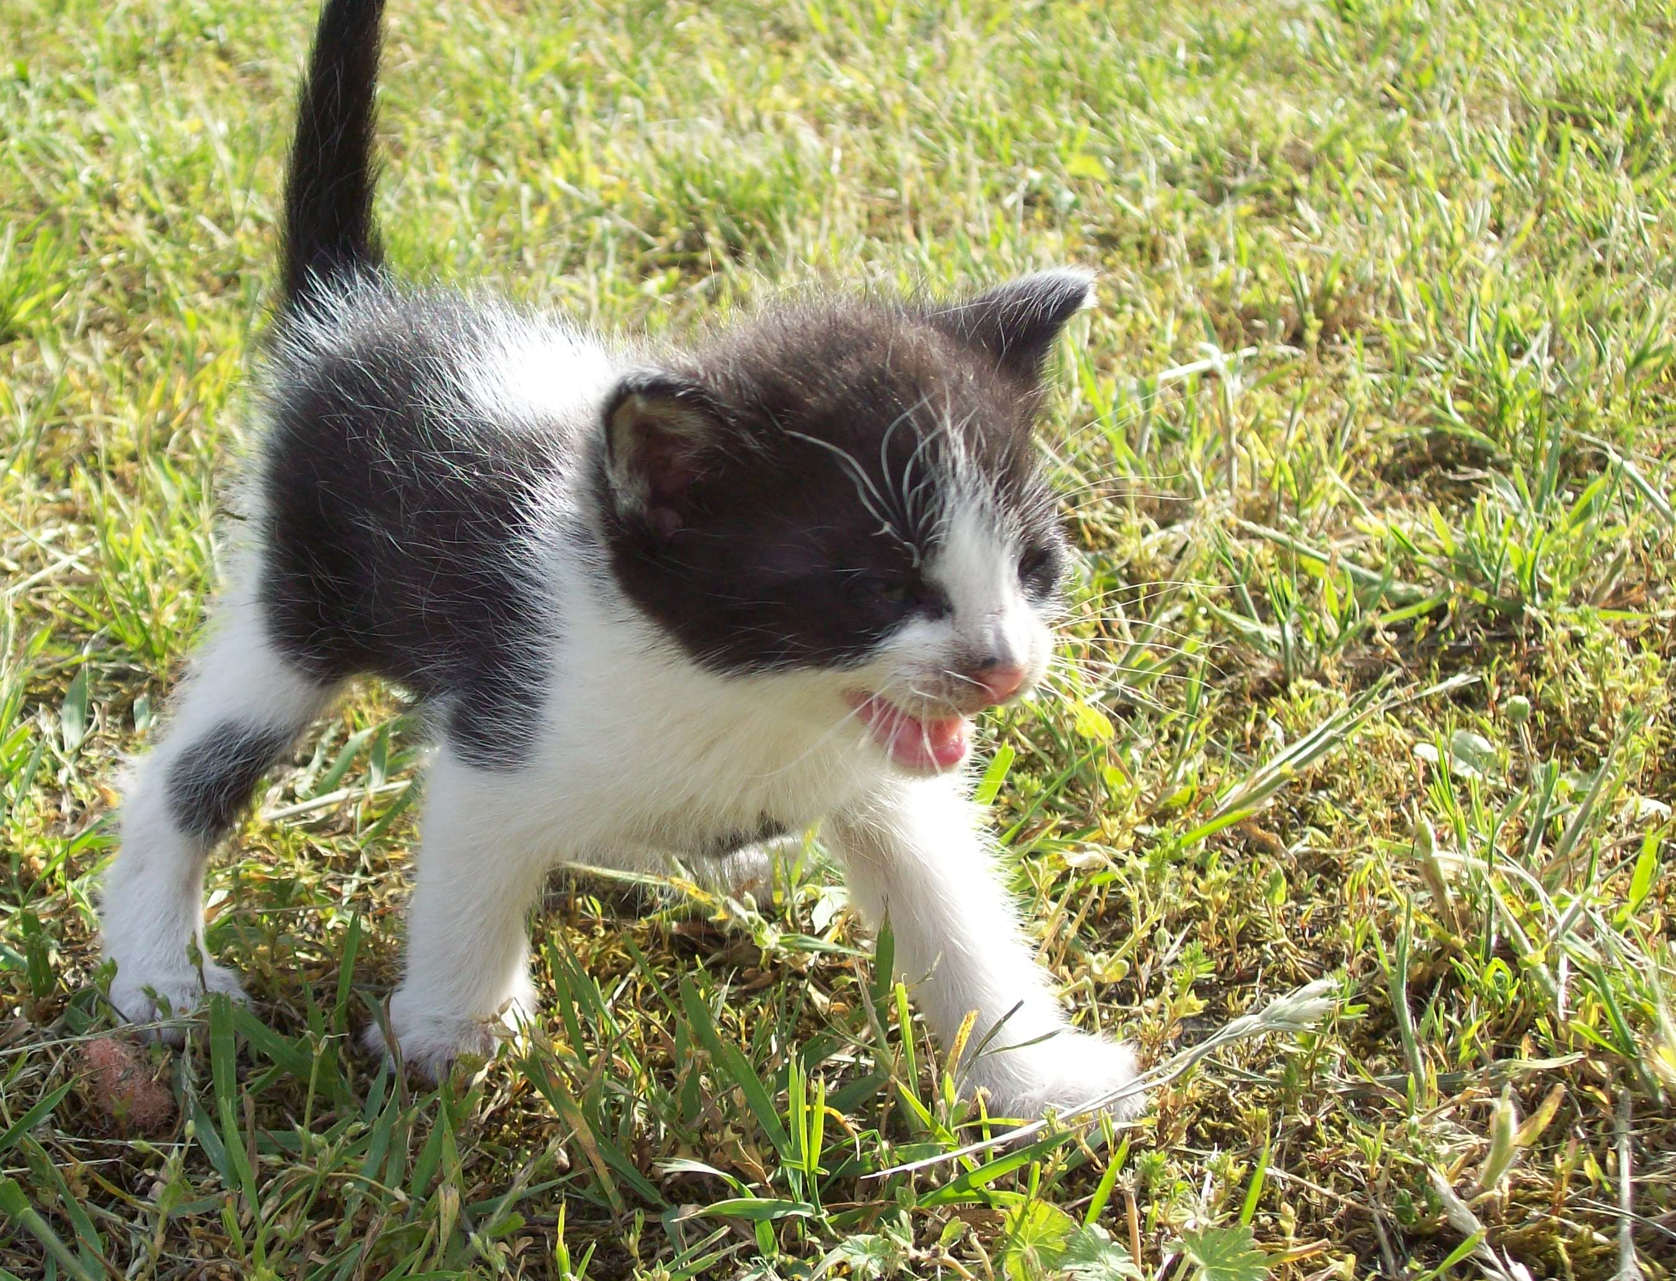
Big-O
We say a function f(n) is “big-O” of another function g(n), and write “f(n) is O(g(n))” iff there exist positive constants c and n₀ such that:
f(n) ≤ c g(n) for all n ≥ n₀.
What you need to know:
O(X) describes an “upper bound”—the algorithm will perform no worse than X
We ignore constant factors in saying that
We ignore behavior for “small” n
Image has been put in the public domain by its author. http://commons.wikimedia.org/wiki/File:Kitten_(06)_by_Ron.jpg

Slide 6
Simplifying Big-O Expressions
We always report Big-O analyses in simplified form and generally give the tightest bound we can
Some examples:
Let f(n) = 3 log₂n + 4 nlog₂n + n………..f(n) is O( ).
Let f(n) = 546 + 34n + 2n²……………..…..f(n) is O( ).
Let f(n) = 2^{n} + 14n² + 4n³……………..…...f(n) is O( ).
Let f(n) = 100……………………....…..…...f(n) is O( ).

Slide 7
Big-O
Applying to algorithms

Slide 8
Applying Big-O to Algorithms
Some code examples:
    for (int i = data.size() - 1; i >= 0; i--){
    for (int j = 0; j < data.size(); j++){
    cout << data[i] << data[j] << endl;
    }
    }
is O( ) where n is data.size().

Slide 9
Applying Big-O to Algorithms
Some code examples:
    for (int i = data.size() - 1; i >= 0; i -= 3){
    for (int j = 0; j < data.size(); j += 3){
    cout << data[i] << data[j] << endl;
    }
    }
is O( ) where n is data.size().

Slide 10
Applying Big-O to Algorithms
Some familiar examples:
Binary search…….…………..is O( ) where n is .
Fauxtoshop edge detection...is O( ) where n is .
0 | 1 | 2 | 3 | 4 | 5 | 6 | 7 | 8 | 9 | 10
2 | 7 | 8 | 13 | 25 | 29 | 33 | 51 | 89 | 90 | 95
R -1 C -1 | R -1 C +0 | R -1 C +1
R +0 C -1 | R +0 C +0 | R +0 C +1
R +1 C -1 | R +1 C +0 | R +1 C +1

Slide 11
Applying Big-O to Algorithms
Some code examples (assume data.size() >= 5):
    for (int i = 0; i < data.size(); i += (data.size() / 5)) {
    cout << data[i] << endl;
    }
is O( ) where n is data.size().

Slide 12
Big-O Extra Slides
Interpreting graphs using the formal definition

Slide 13
f₂ is O(f₁)
“f(n) is O(g(n))” iff
$$∃c,n_{0}>0, s.t. ∀n≥n_{0}, f(n)≤c∙g(n)$$
TRUE
FALSE
Why or why not?
f₁
f₂

Slide 14
f(n) is O(g(n)), if there are positive constants c and n₀ such that f(n) ≤ c * g(n) for all n ≥ n₀.
Because we ignore the constant coefficient that determines slope, f1 and f2 look the “same” in Big-O analysis
f₂ is O(f₁) and f₁ is O(f₂)
  Math version: We can move f₂ above f₁ by multiplying by c (we can change the slope of f₂ by a constant factor)
f₁
f₂

Slide 15
f₃ is O(f₁)
“f(n) is O(g(n))” iff
$$∃c,n_{0}>0, s.t. ∀n≥n_{0}, f(n)≤c∙g(n)$$
f₃
TRUE
FALSE
The constant c cannot rescue us here “because calculus.”
f₁

