Slide 1
Supervised Clustering
Pranjal Awasthi, Carnegie Mellon University
Reza Bosagh Zadeh, Stanford University
Clustering is usually unsupervised
Full supervision renders task meaningless, find middle ground by interacting with teacher
Remove subjective ambiguities according to teacher
[Balcan, Blum’08] : A PAC style query model for clustering.

Slide 2
The Model
Limited interaction with teacher
Only query allowed: “Here’s what I think the clustering should be”
Teacher responds with one of:
  Split this cluster: c
  Merge these two clusters: c₁ and c₂
How many queries can we get away with in the worst case?

Slide 3
Main Results
Previous query bound of O(k³ log |C|) known for any concept class C.
We improve the bound to O(k log |C|).
Give algorithms for clustering geometric concept classes.
Present noisy versions of model and give query bounds.
What if we knew about separation properties of the dataset?

Slide 4
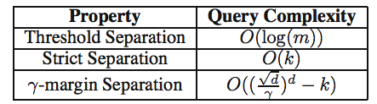
Dataset Separation
Worst case number of queries under some “separation” properties:
The better separated the dataset, the fewer queries required
Lots of open problems!

