Slide 1
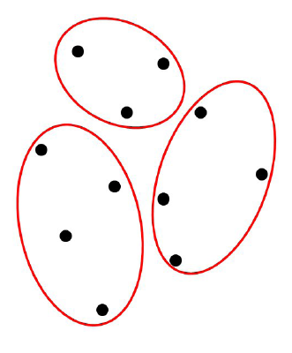
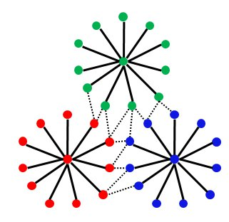
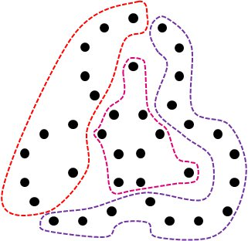
Supervised Clustering
Pranjal Awasthi Reza Bosagh Zadeh
Clustering
Find a meaningful partitioning of the data.
Unlike supervised learning no class labels.
An algorithm for any concept class C
S = given set of m points.
Define VS = {all k-clusterings of S using C.}
For h µ S, define VS(h) = {R 2 VS|R is consistent
with h.}
The Algorithm
At step i, find the largest set of points h_{i} such that
|VS(h_{i})| ¸ ½ |VS|.
Output h_{i} and repeat until all points are clustered.
On split (h_{i}) : VS ← VS \ VS(h_{i}).
On merge(h_{i} , h_{j}): VS ← VS (h_{i} [ h_{j})
Dynamic model
At each time step the algorithm sees a fresh set of points from S. Ex: Think of personalized Google News.
Theorem:
Can cluster the class of intervals on a line
using O(k (log |S|)) queries.
Usually one uses distance information to
optimize an objective function, ex: k-means.
Separation Properties
What if instead, the dataset satisfies some natural separation conditions?
Strict Threshold Separation:
9 t such that within cluster distances · t and outer distances > t.
Can cluster using O(min(k,log m)) queries.
Threshold Separation:
Points within a cluster are more similar to one another than to points outside the cluster.
Can cluster using O(k) queries.
Margin Separation:
Any two clusters are separated by a margin of °.
Can cluster using at most (d/°²)^{(d/2)} – k
queries.
Theorem:
The algorithm uses O(k log |C|) queries in the
worst case.
Clustering geometric classes
Concept class C = axis aligned rectangles in R^{d}
Main idea behind the Algorithm:
View the problem as d independent
problems of clustering intervals on a line.
Balcan and Blum, 2008
Apriori no reason to believe that the
output of an algorithm is the “true”
clustering.
Remove this ambiguity by introducing
limited supervision.
Inspired by the EQ model for learning.
Theorem:
Can cluster the class of axis aligned rectangles in
R^{d} using O(k d (log m)^{d}) queries.
The model [Balcan, Blum’08]
The target is a k-clustering of m points.
Cluster i is a concept c _{i} in concept class C.
x 2 cluster i if c_{i}(x) = 1.
The algorithm proposes a clustering to the
teacher.
Teacher responds with:
- Split(h_{i}): h_{i} is impure
- Merge(h_{i} , h_{j}): The two clusters
belong together.
Goal: fast algorithms, few queries.
Corollary:
Can cluster hyperplanes in R^{d} with a known set
of slopes of size s using O(k d s (log m)^{d}) queries.
Open problems
Algorithms for clustering linear separators,
conjunctions, etc.
Efficient algorithms for clustering geometric
classes in the noisy/dynamic models.
Connections to EQ model/ active
learning?
Models for clustering with other natural
forms of feedback.
Noisy model
´ Noise Model: Merges can be imperfect.
Imperfect Merge:
Merge(h_{i,} h_{j}) : Most of the two clusters belong
together (at least a 1-´ fraction).
In this work
We resolve a few open questions from
[Balcan, Blum’08].
Present natural extensions of the original
model.
Theorem:
Can cluster the class of intervals on a line using
O(k (log ´ m)²) queries.

